Slide 1
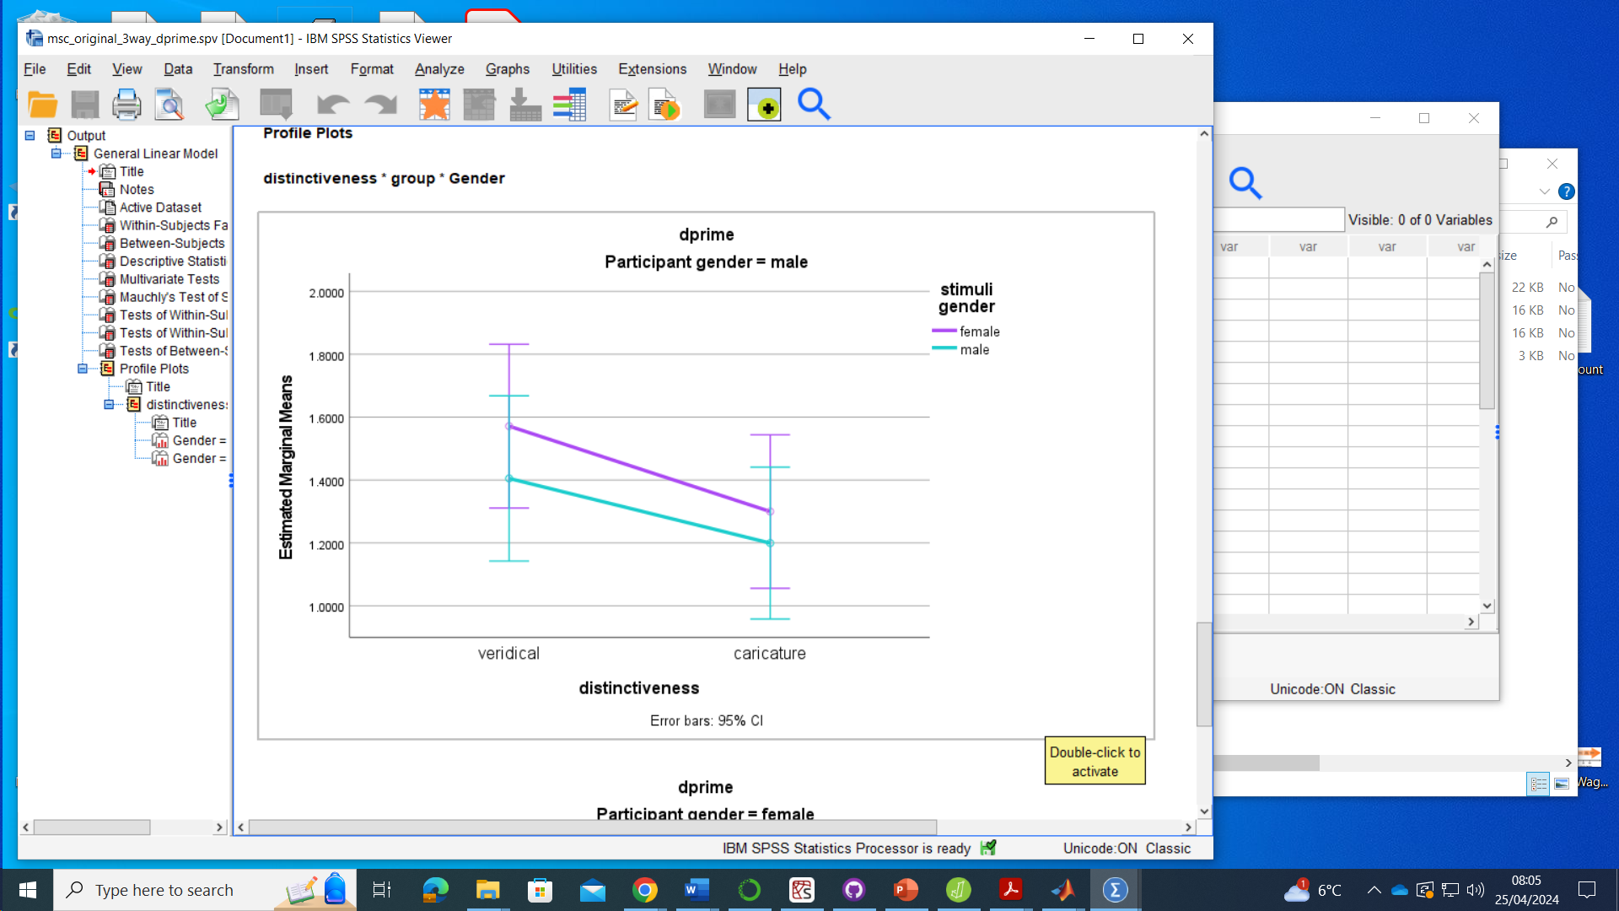
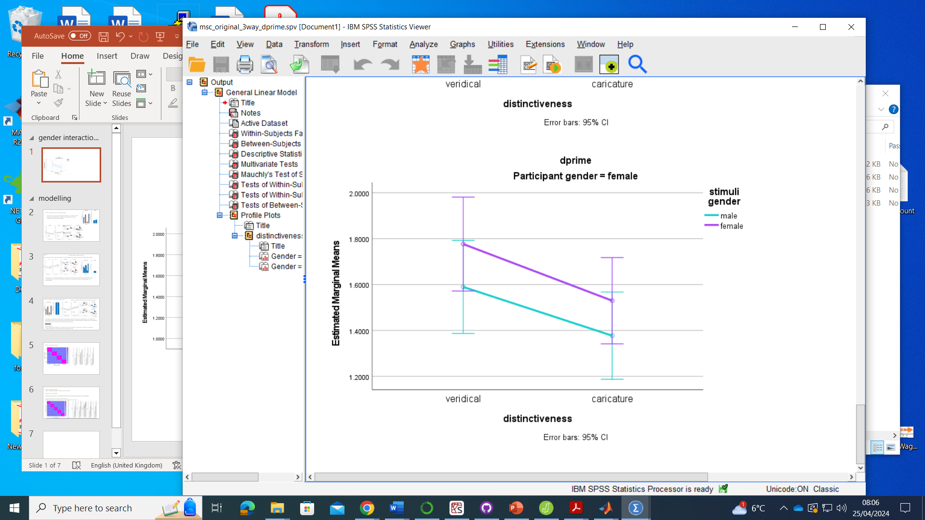
Original Msc study

Slide 2
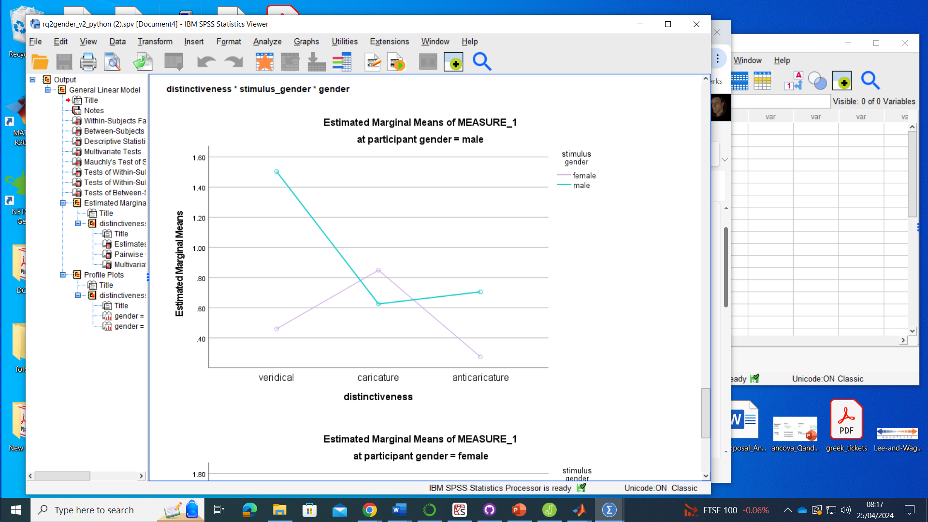
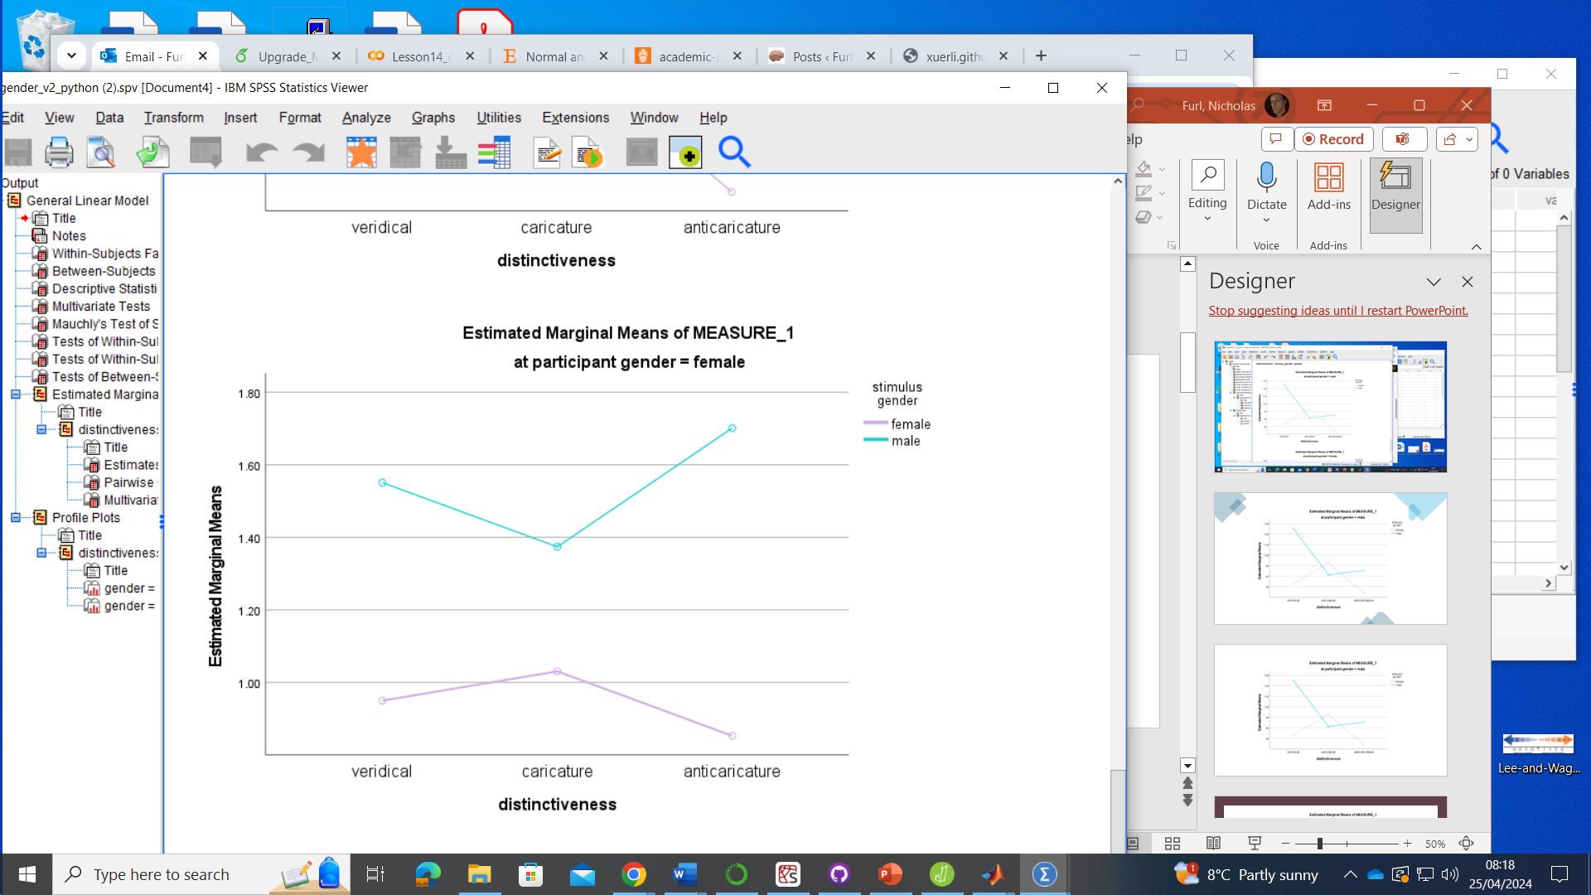
Gender study

Slide 3
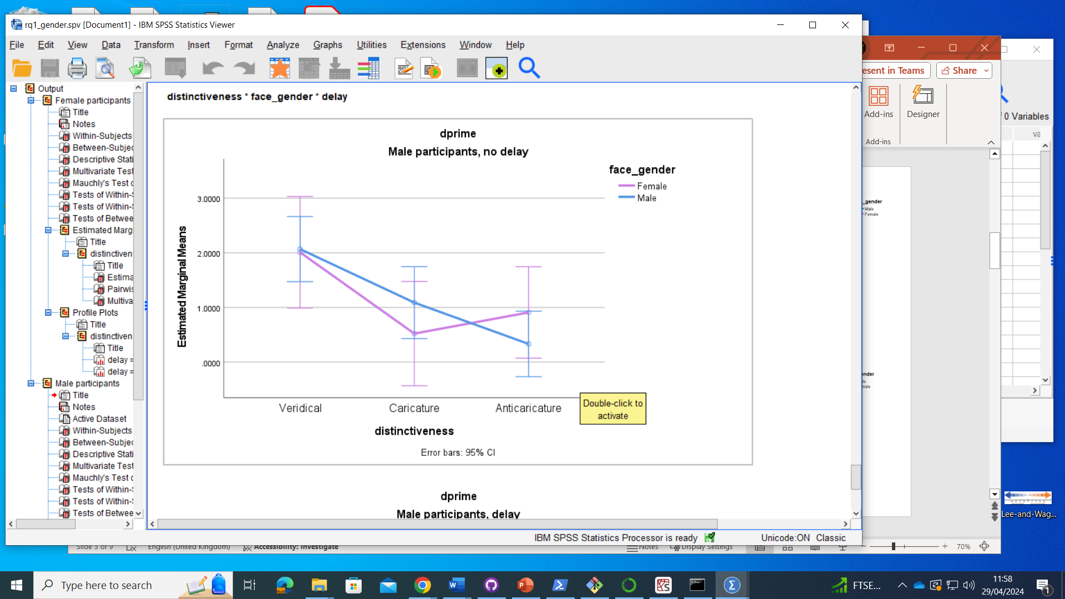
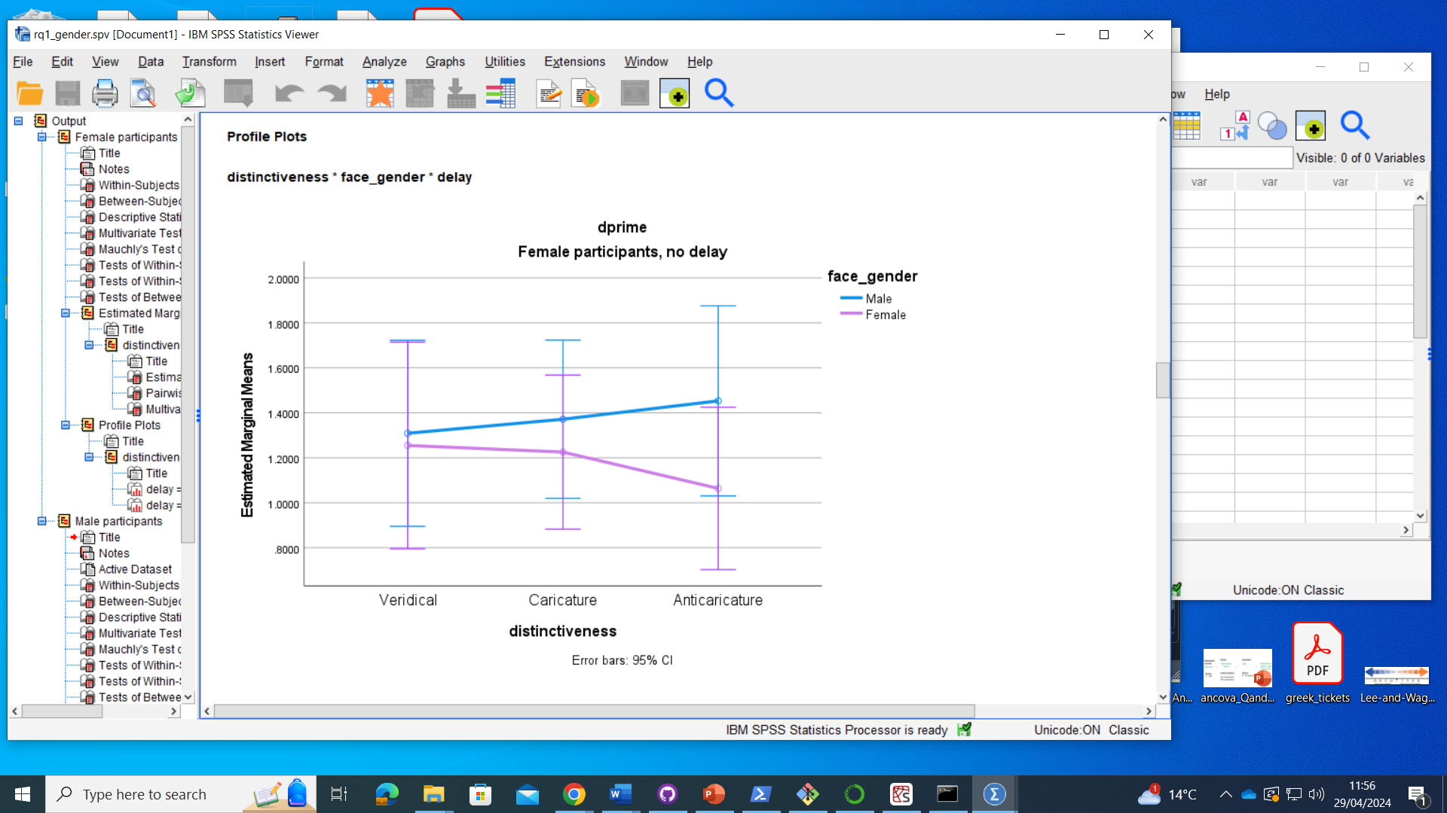
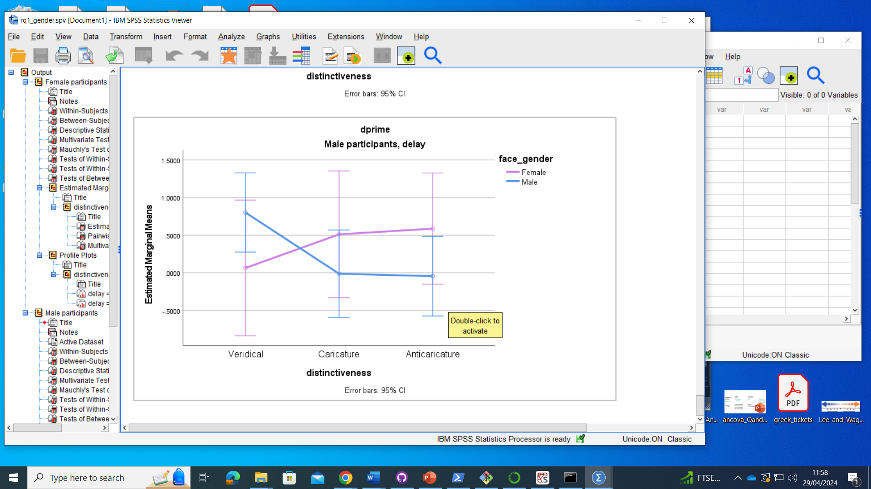
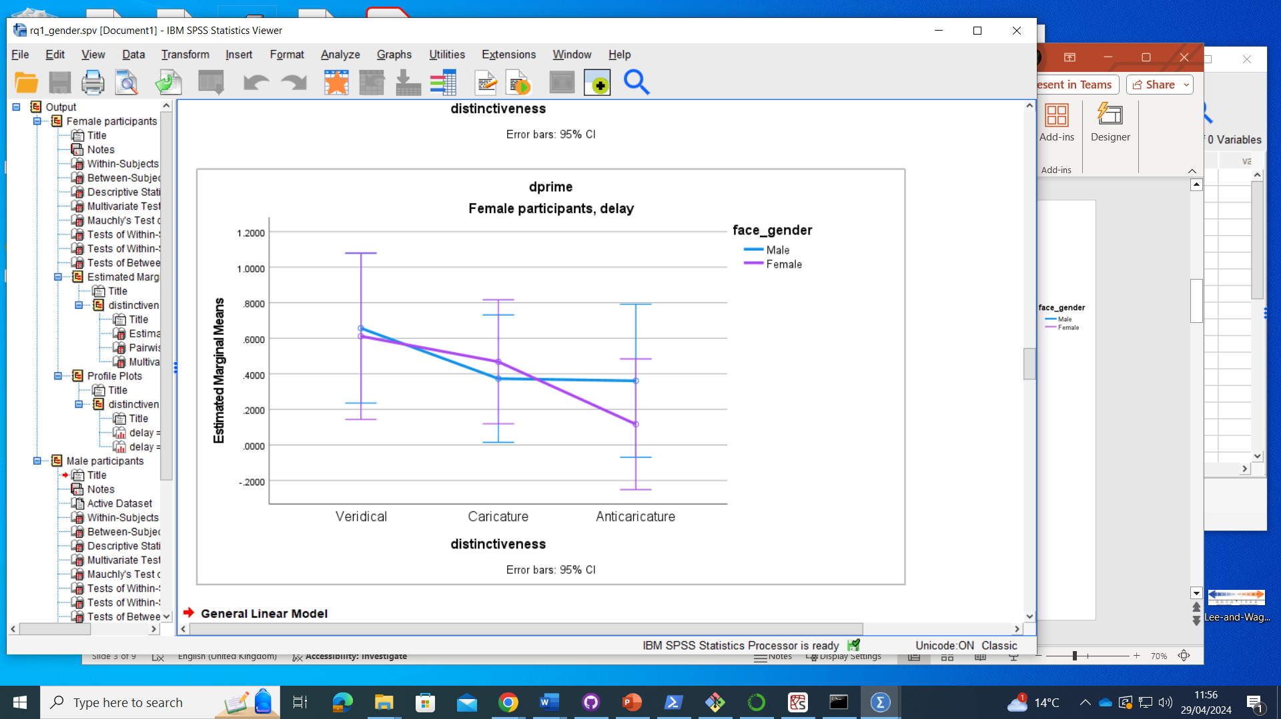
RQ1

Slide 4
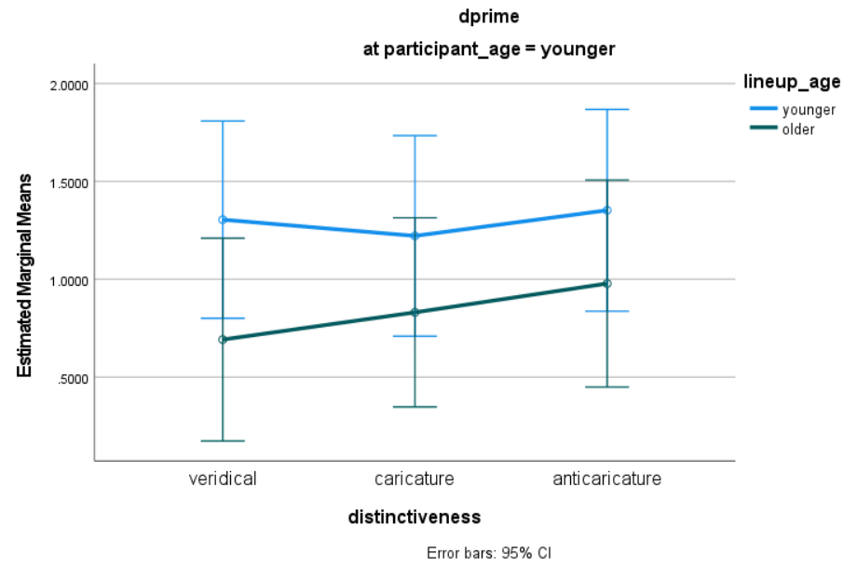
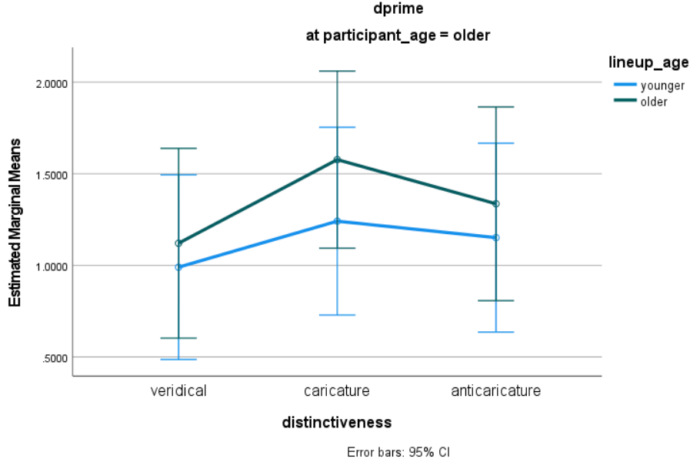
Age study

Slide 5
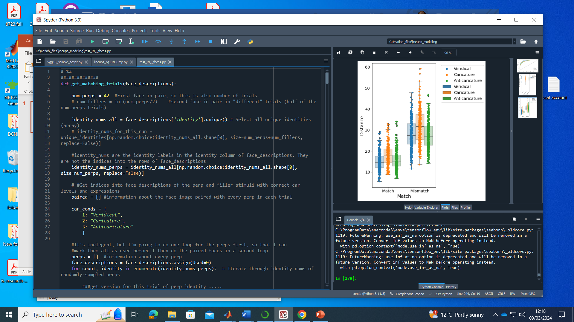
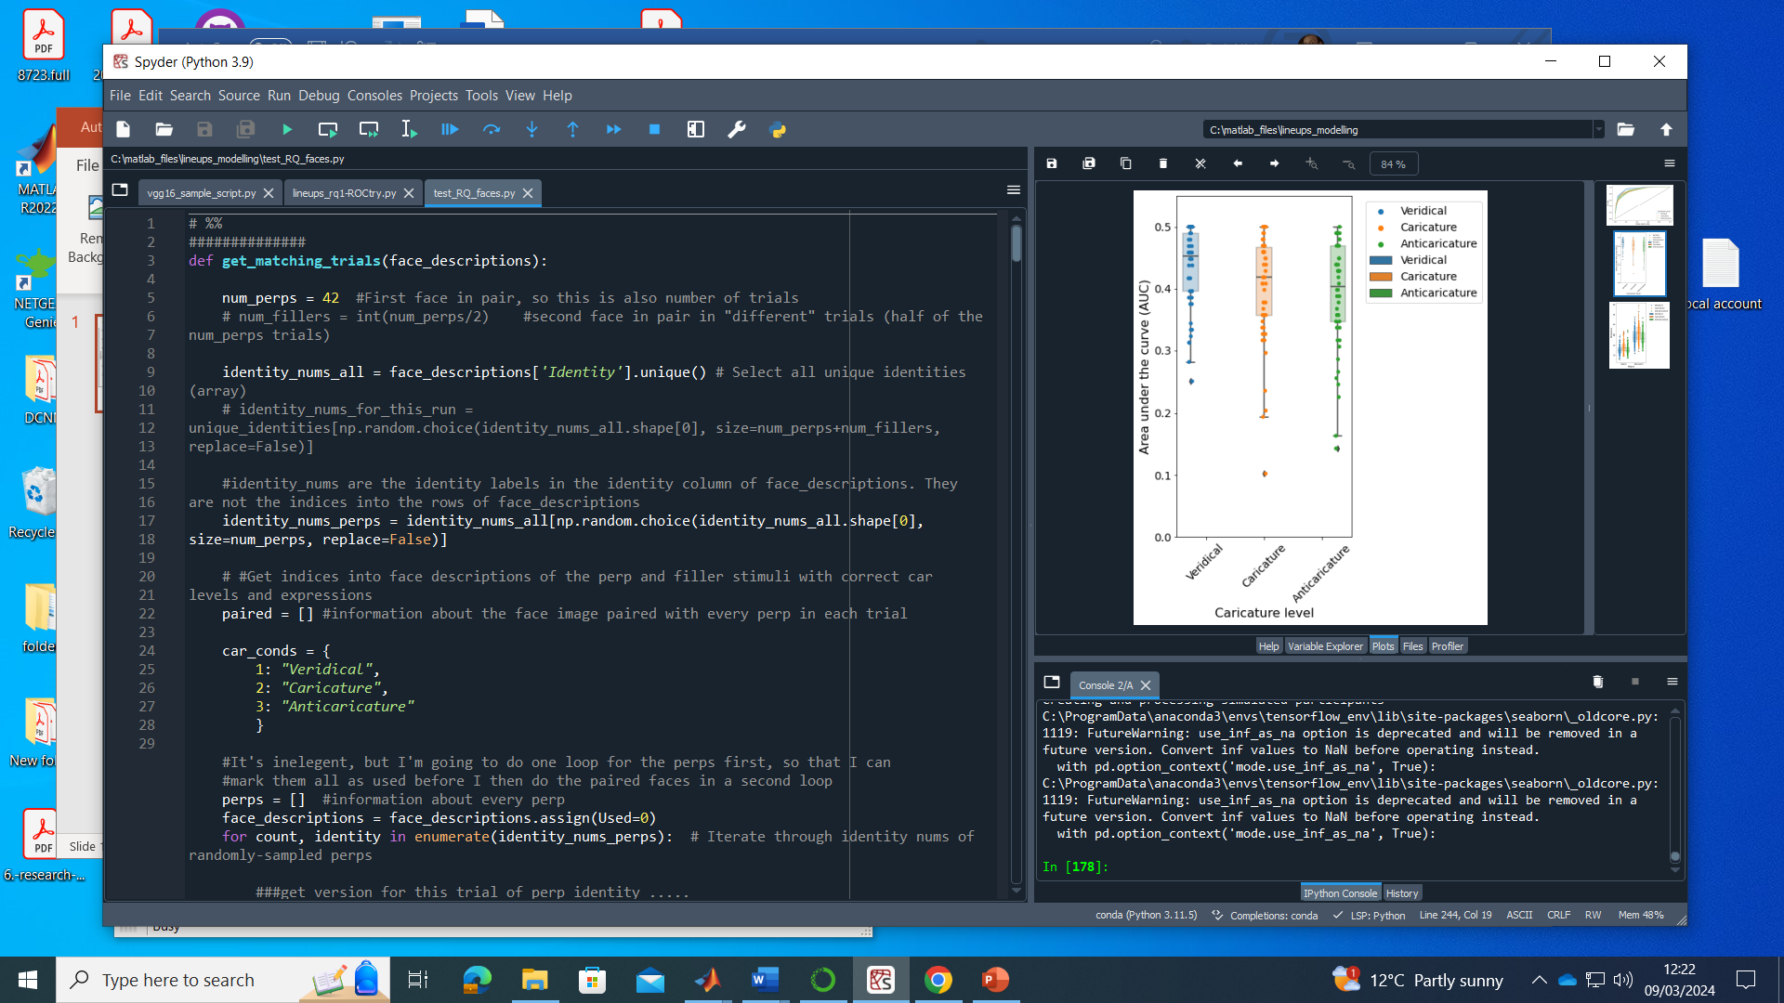
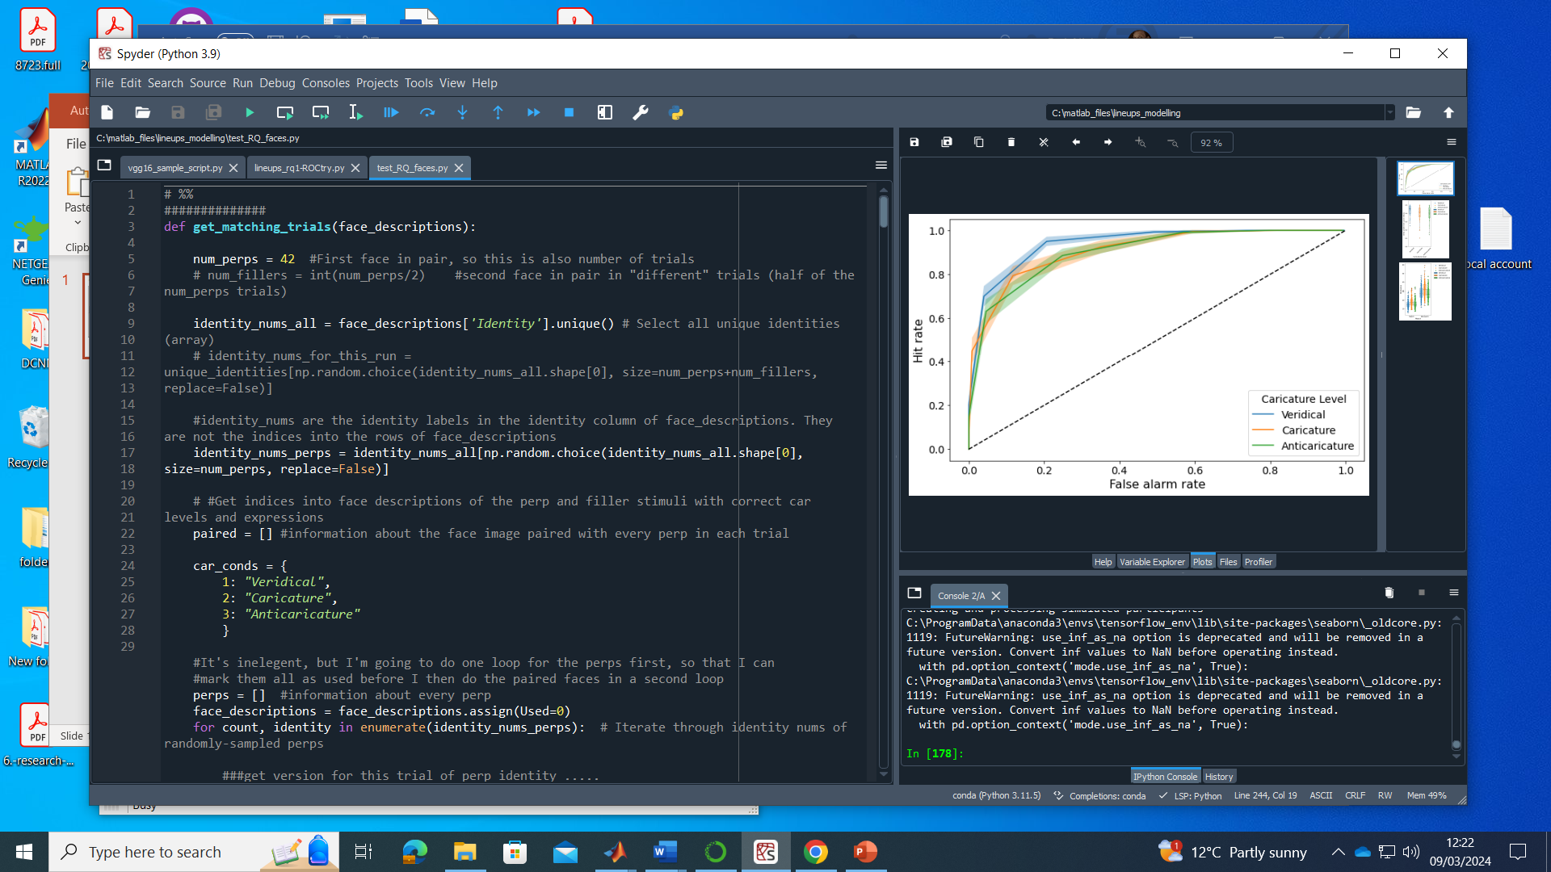
RQ1 stimuli, vgg16 imagenet, Euclidean distances, males & females

Slide 6
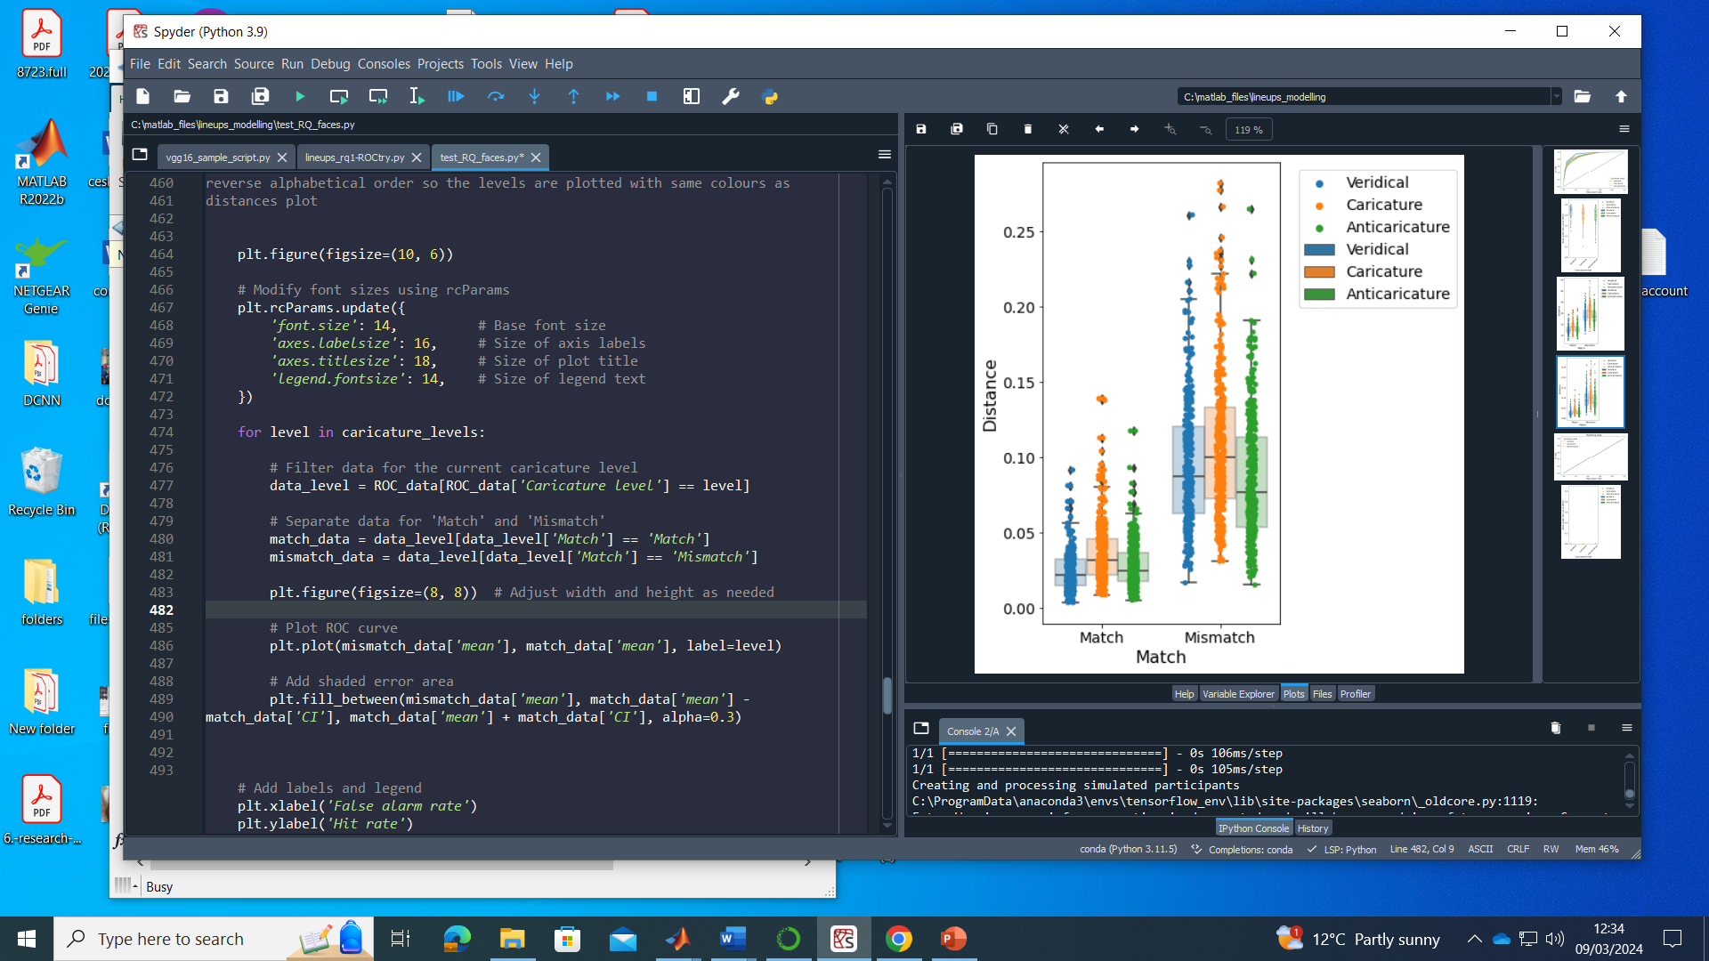
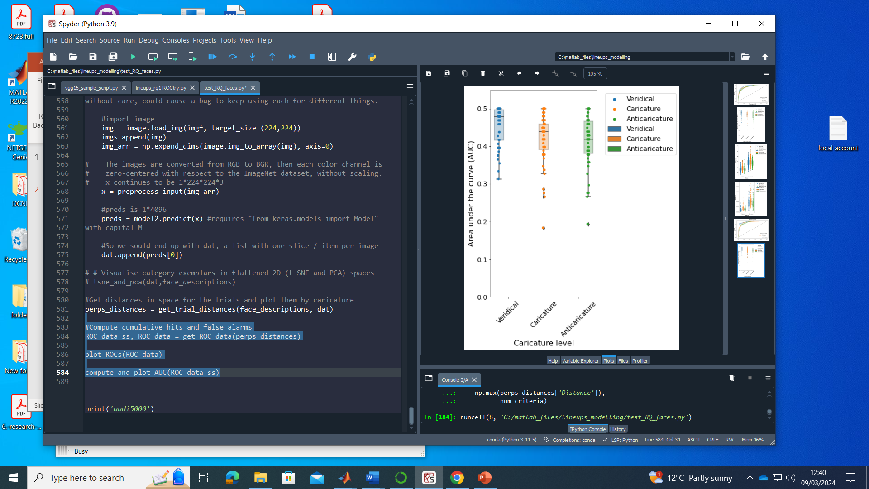
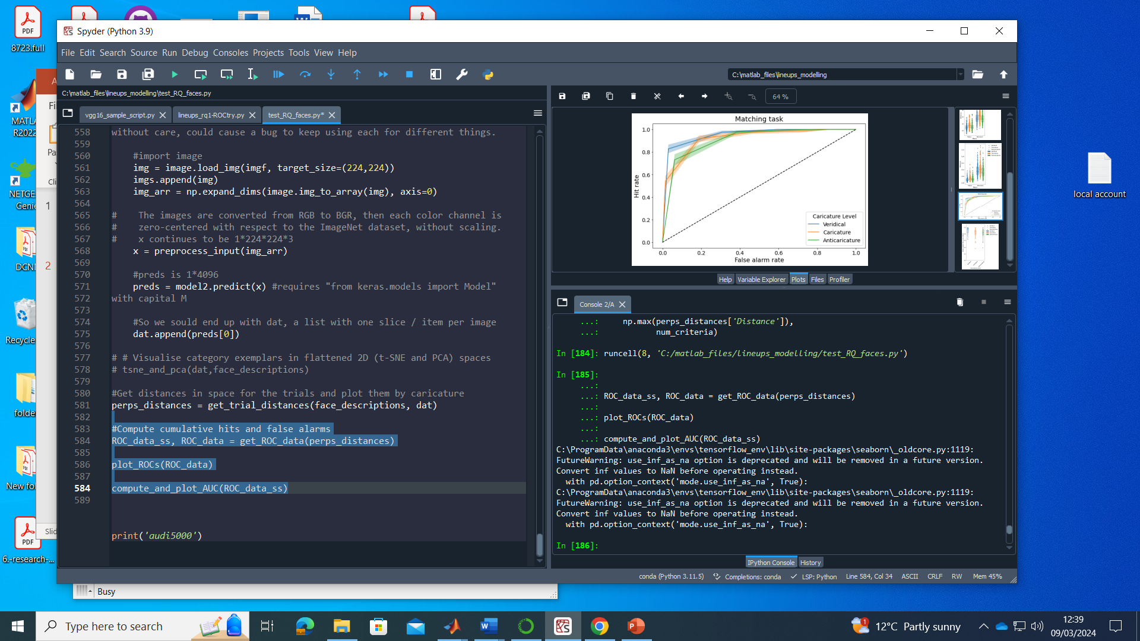
RQ1 stimuli, vgg16 imagenet, cosine distances, males & females

Slide 7
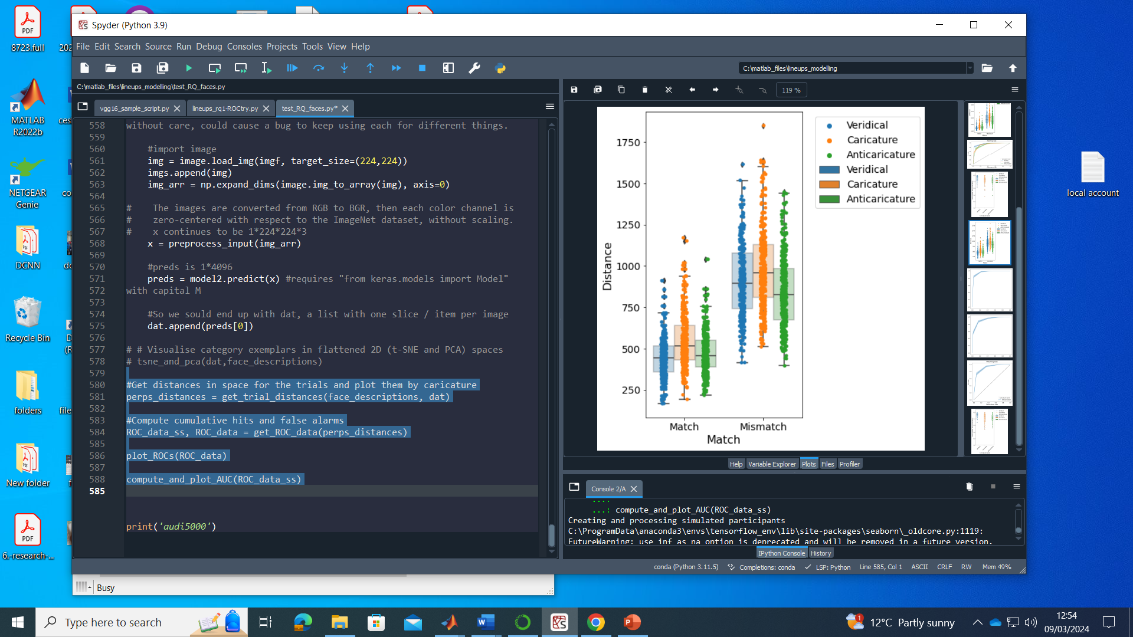
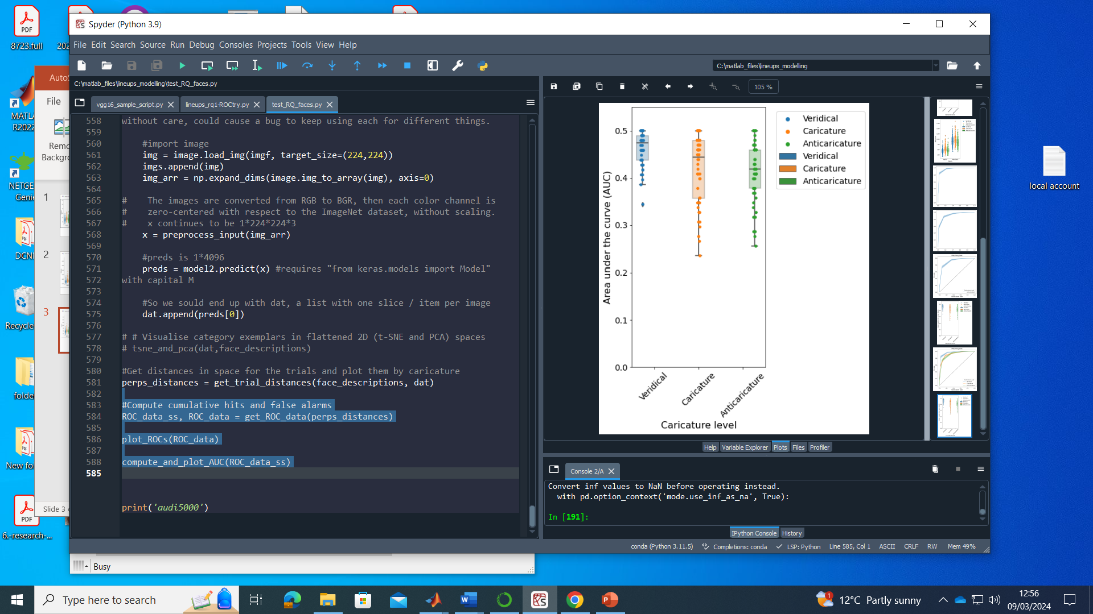
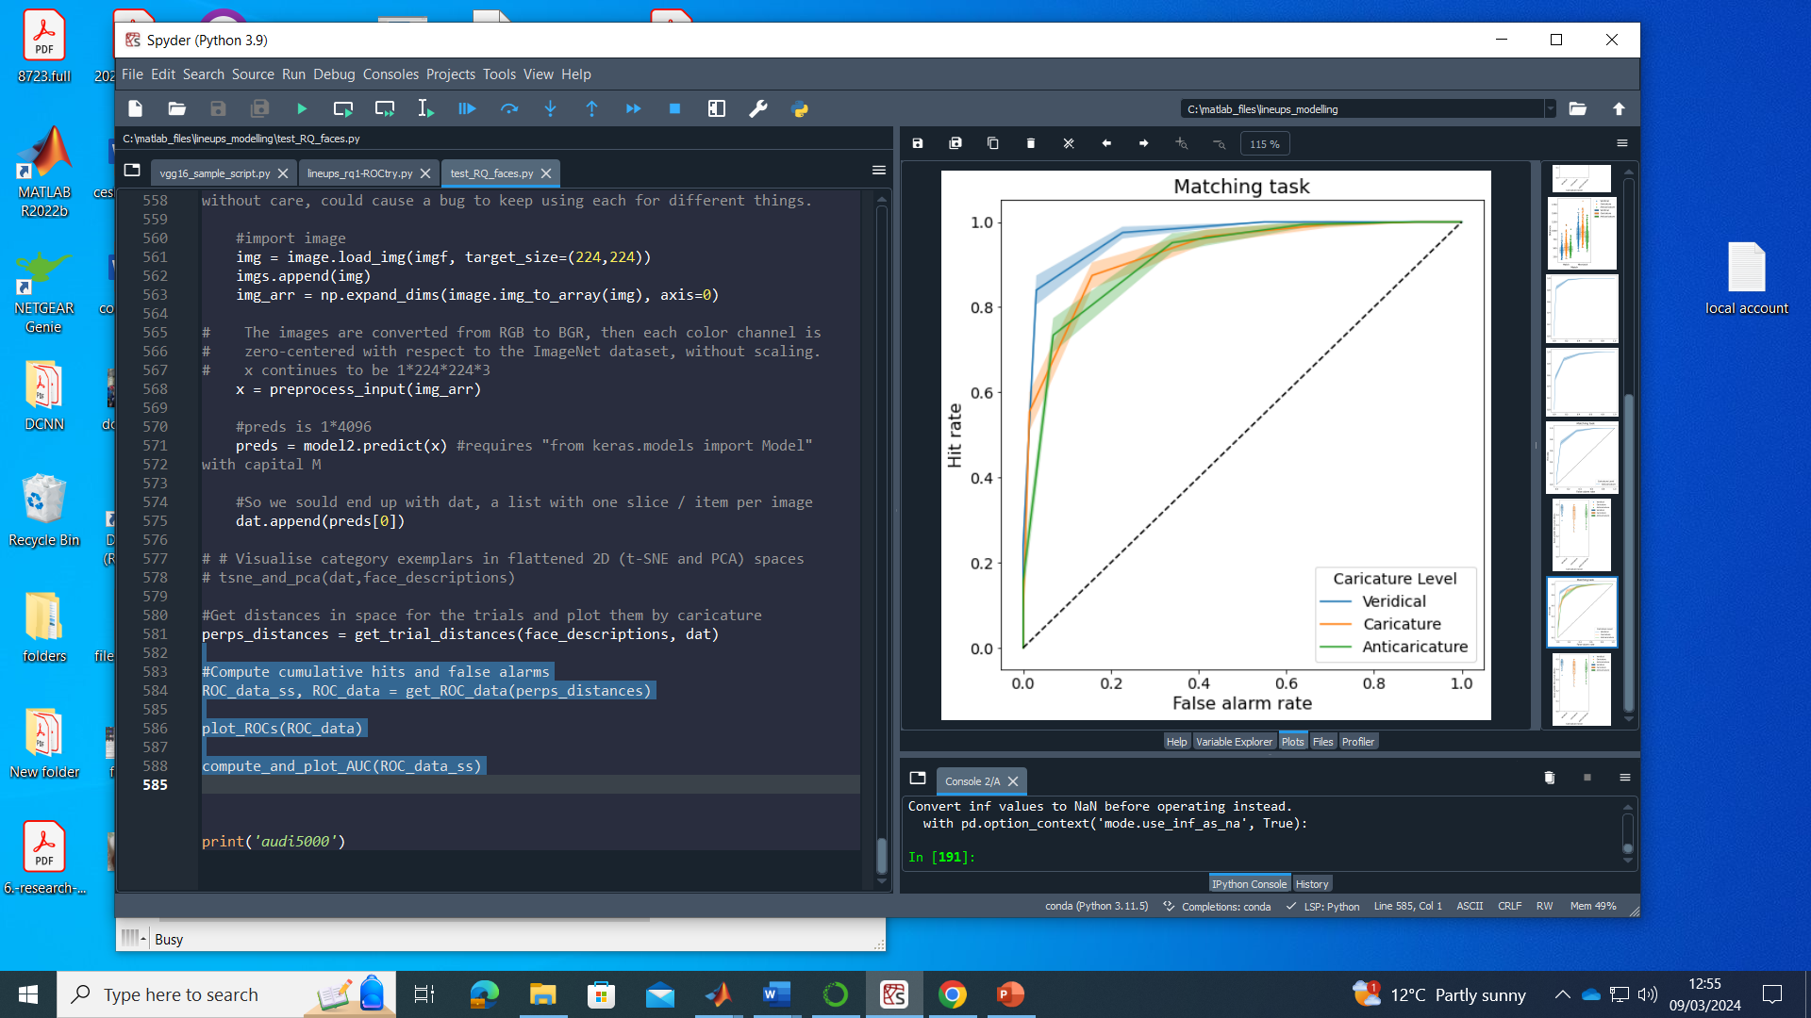
RQ1 stimuli, vgg16 imagenet, cityblock distances, males & females

Slide 8
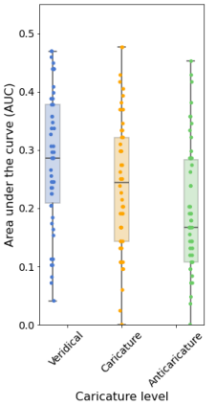
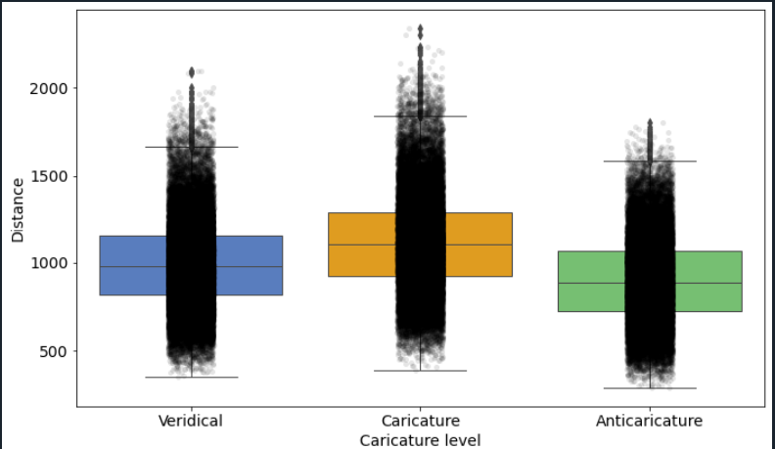
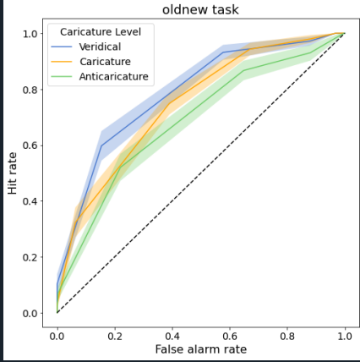
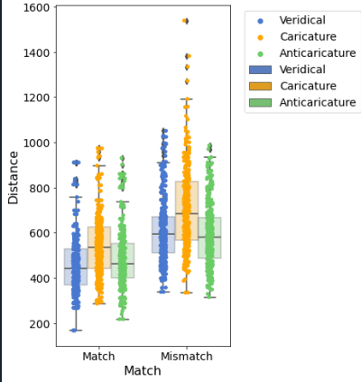
RQ1 old / new task imagenet

Slide 9
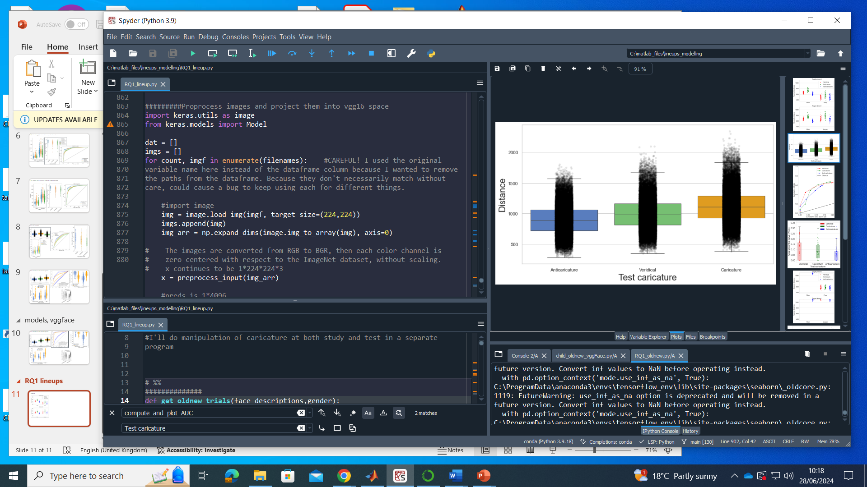
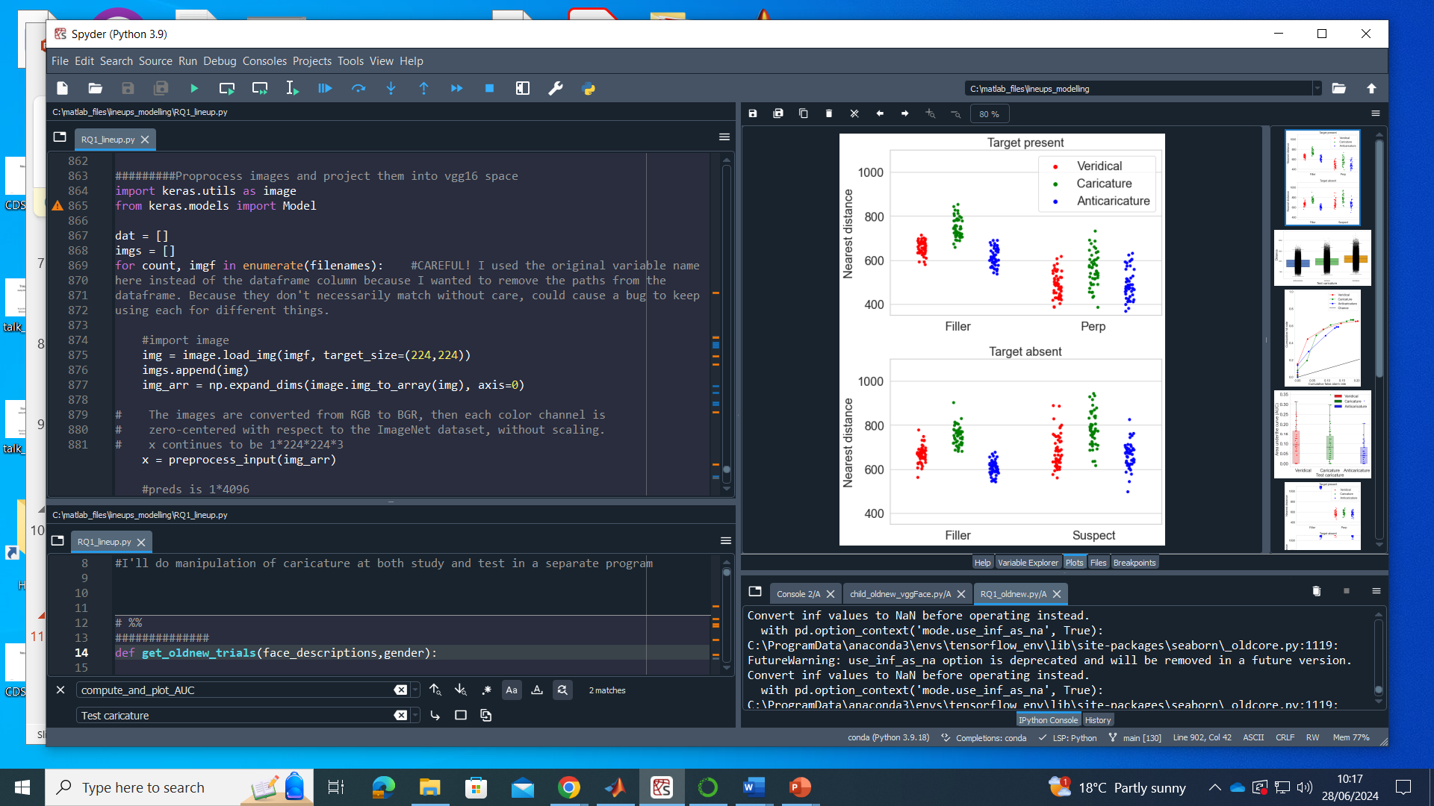
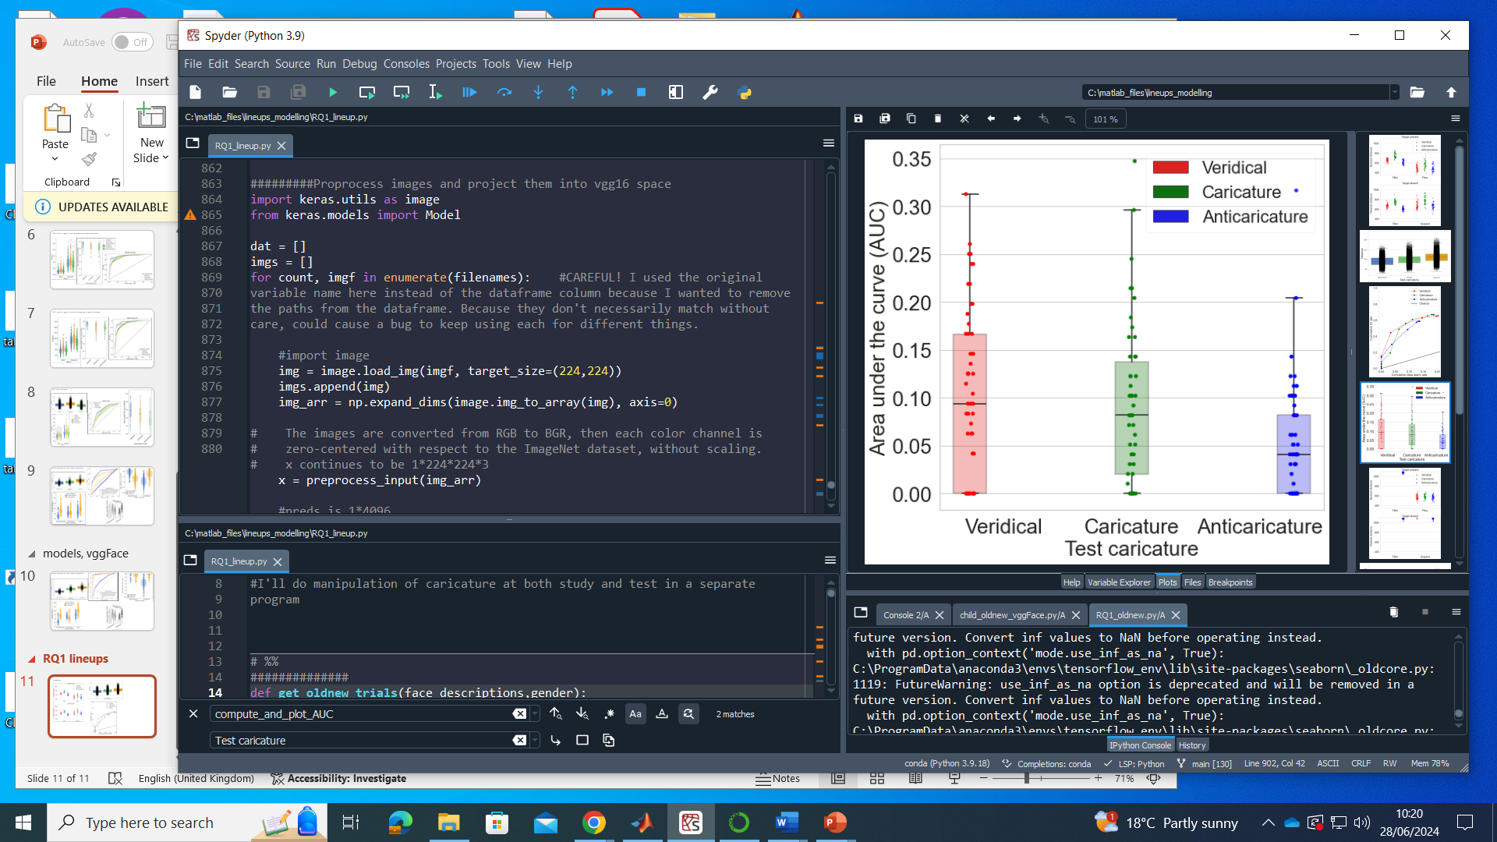
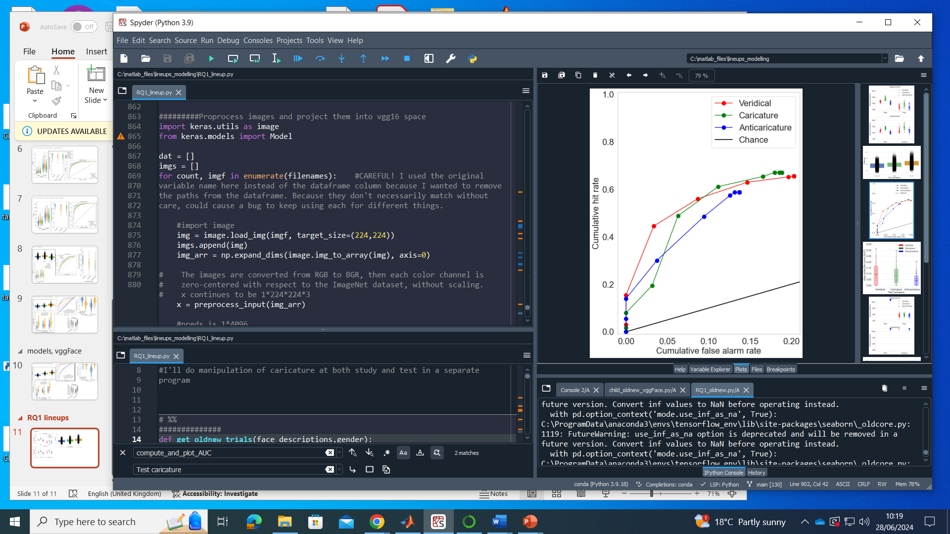
Imagenet

Slide 10
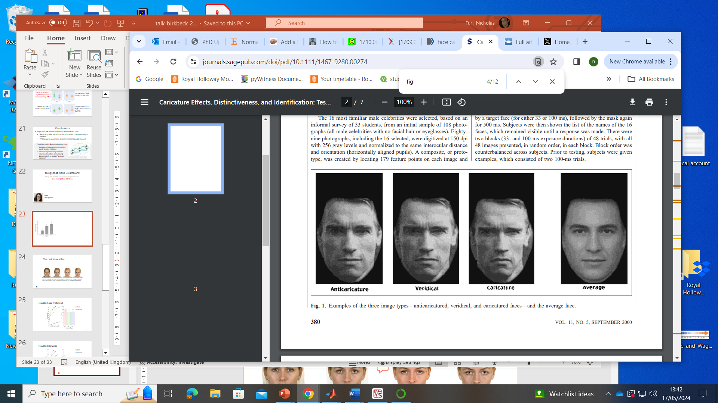
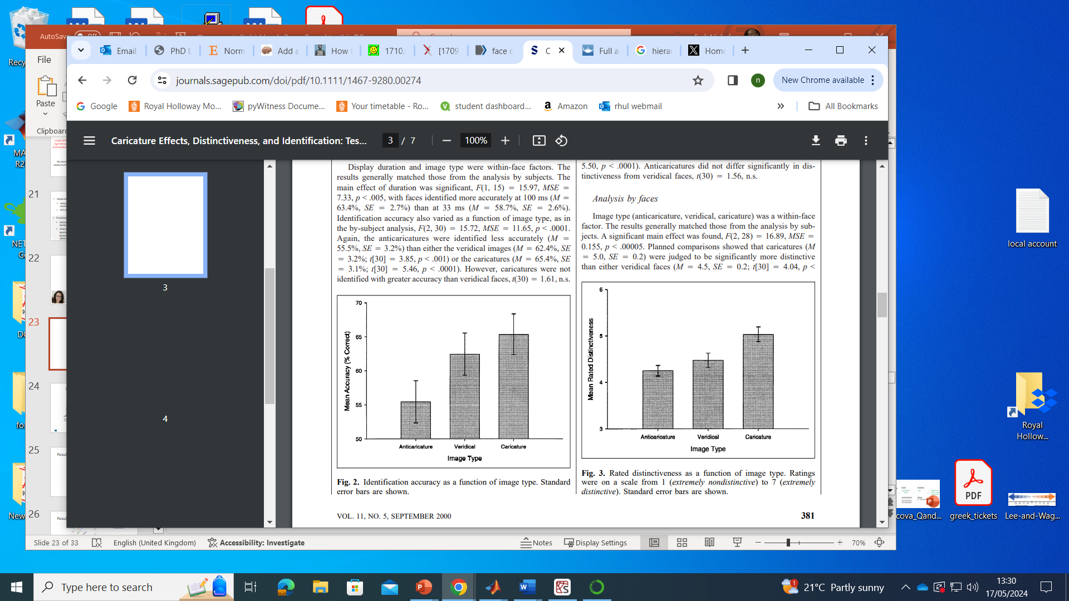
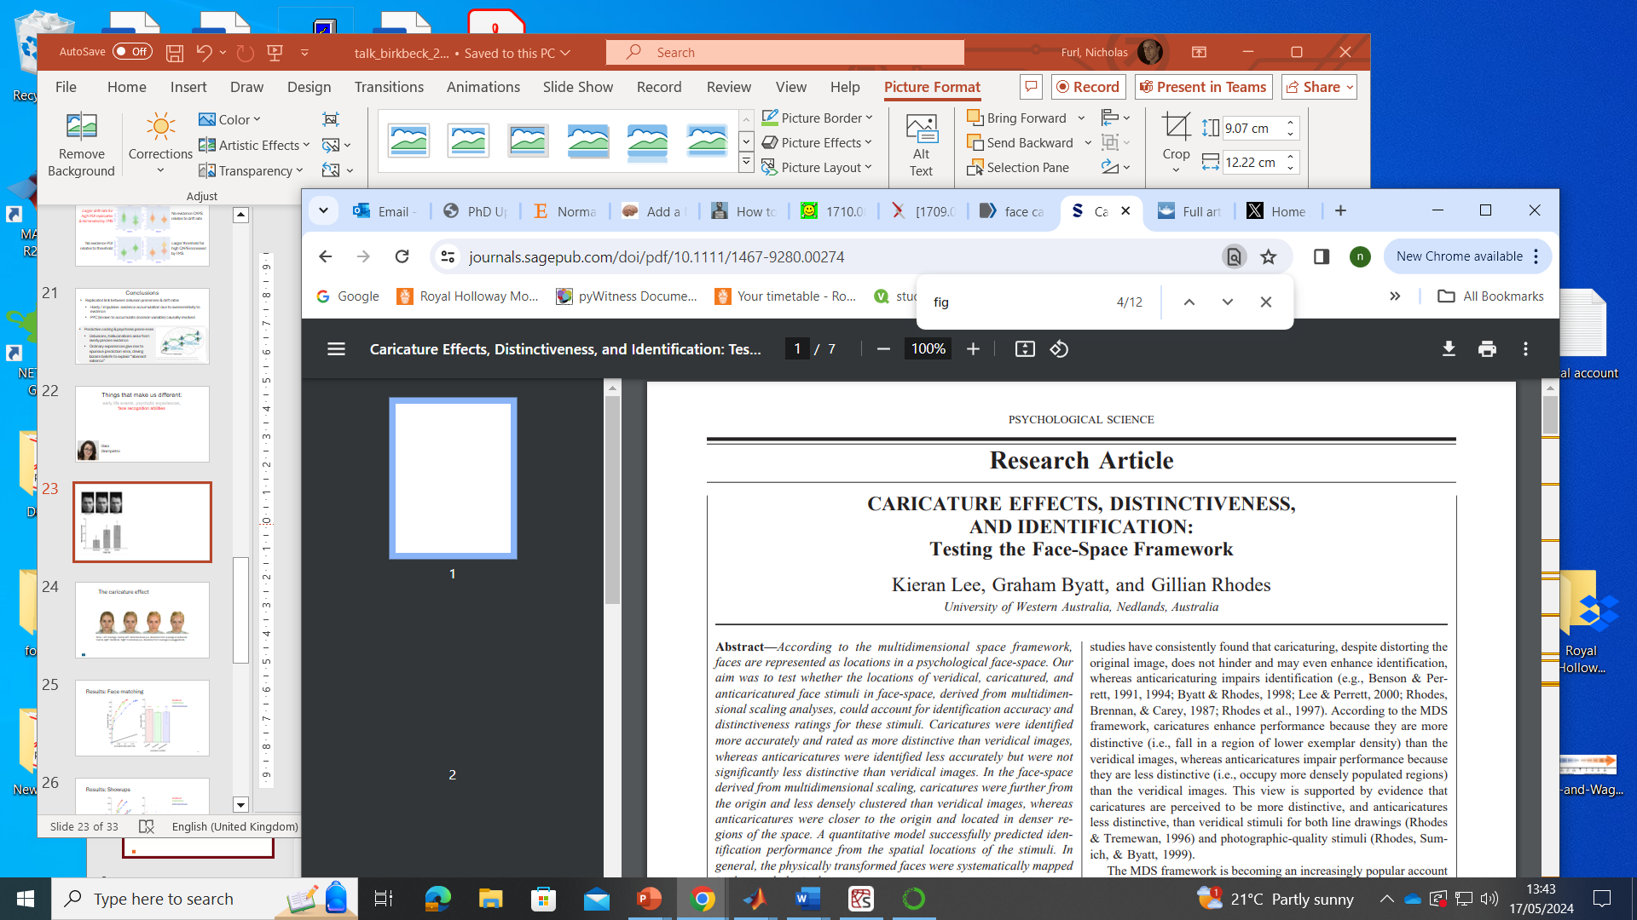
Famous superportraits
Caricatured test Swartzenegger better recognised
“More Swartzenegger” than learned veridical version

Slide 11
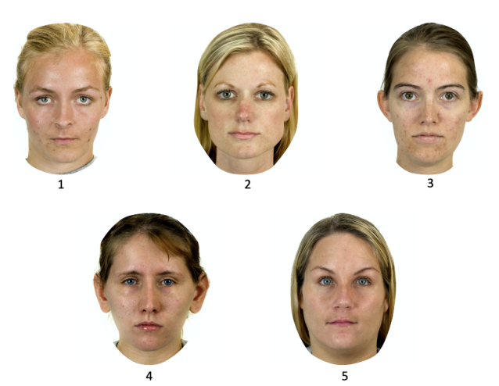
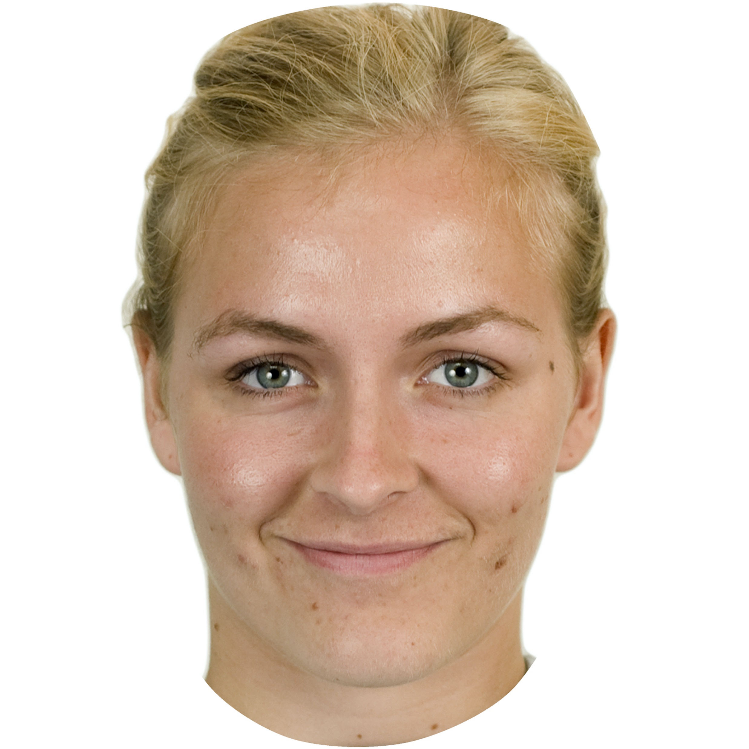
Can caricature aid identification of newly-learned faces in eyewitness lineups?
Perpetrator (“perp”)
Caricatured lineup, may / may not contain perp

Slide 12
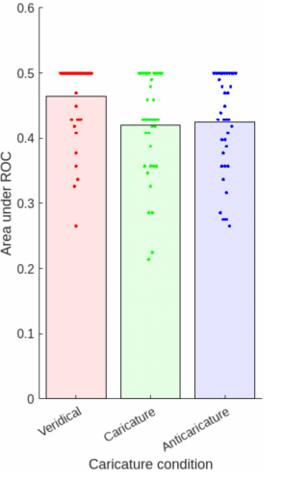
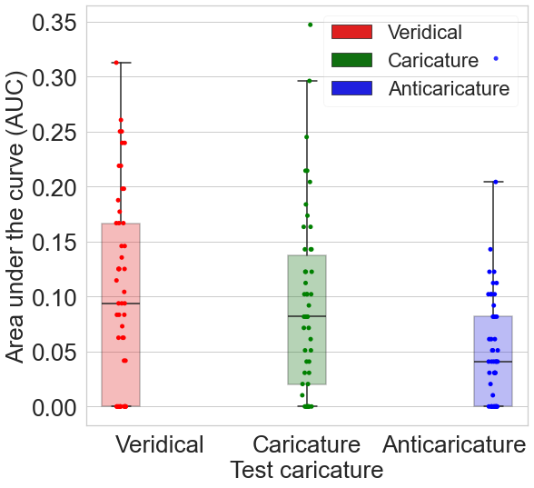
Veridical test faces most accurate, NOT caricatures
Deep convolutional neural network
7

Slide 14
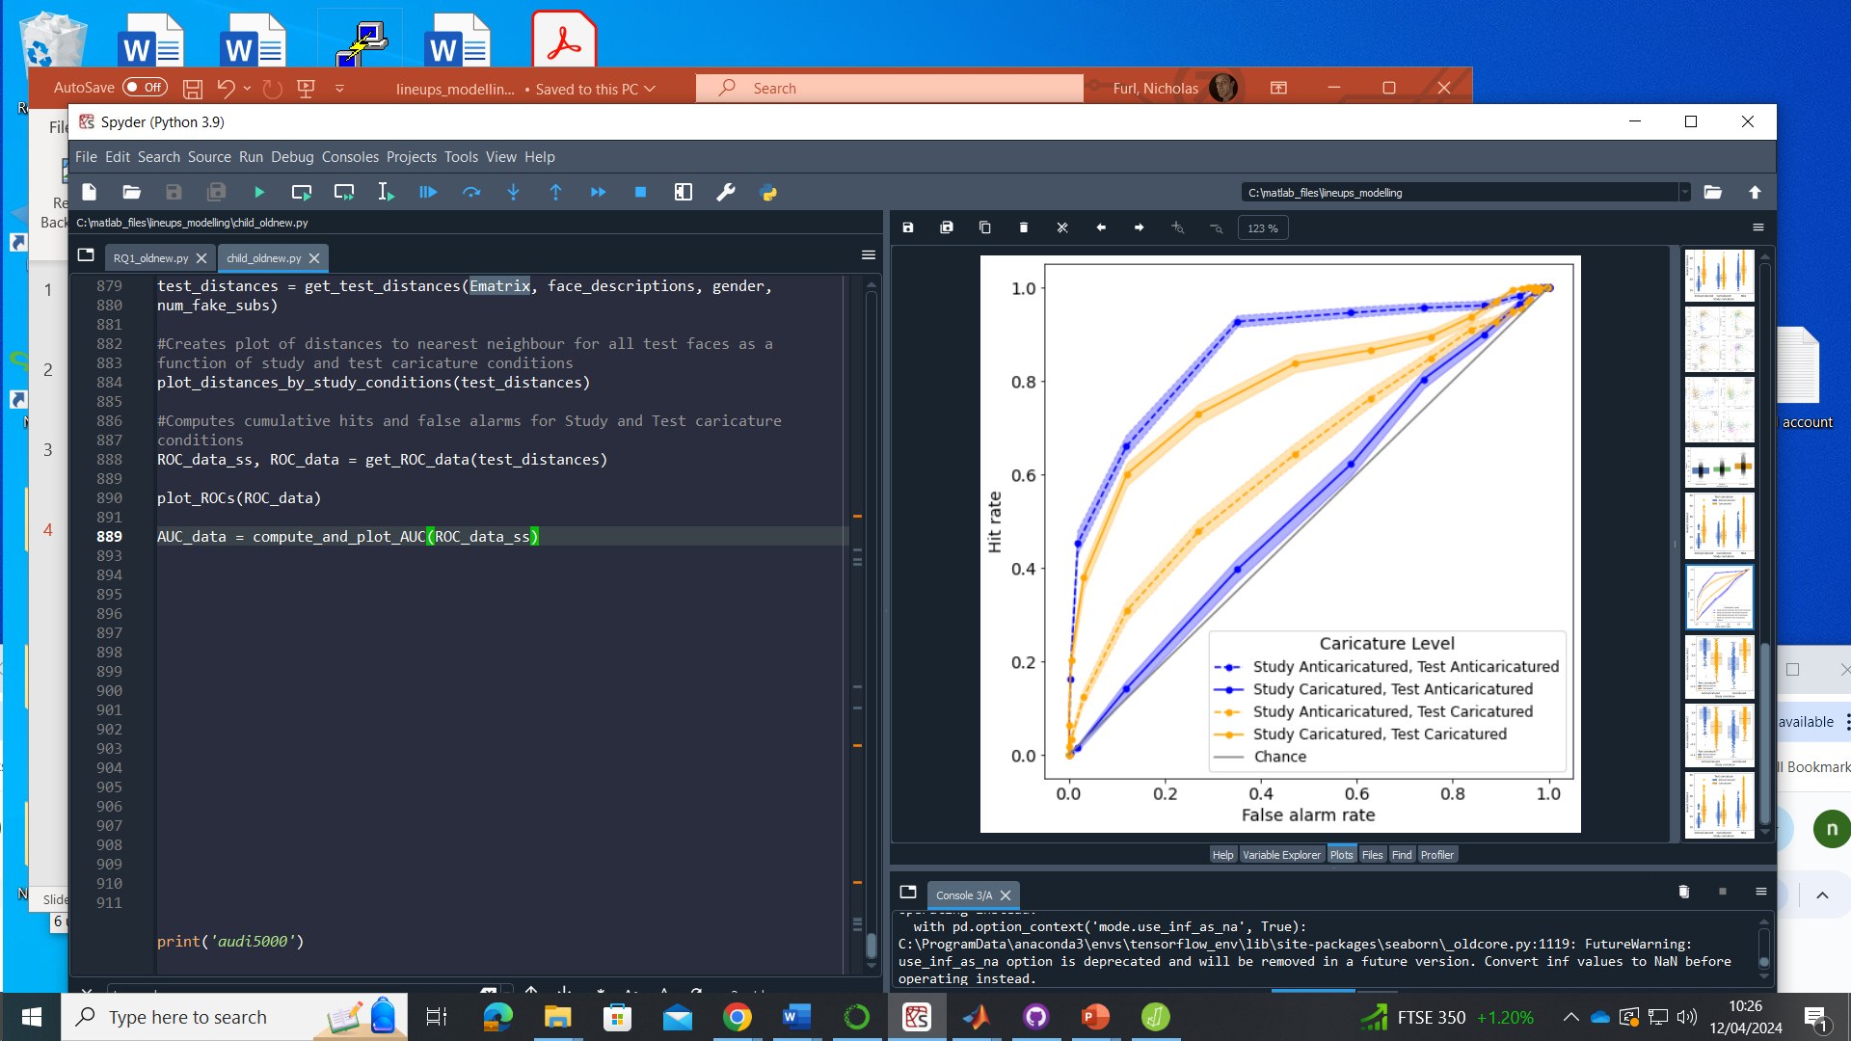
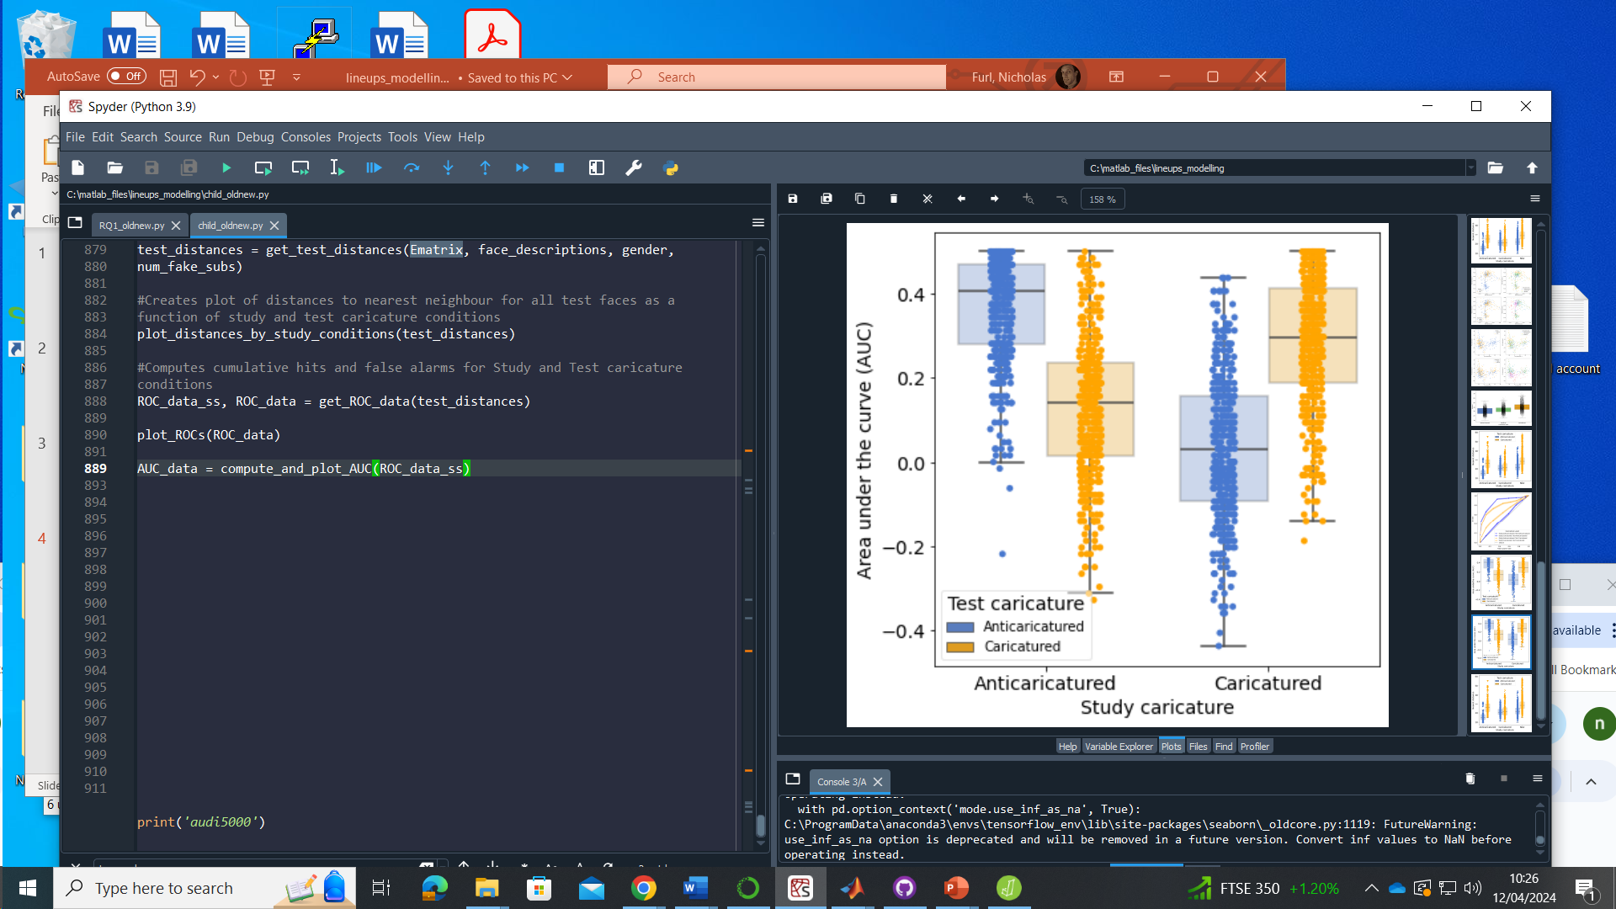
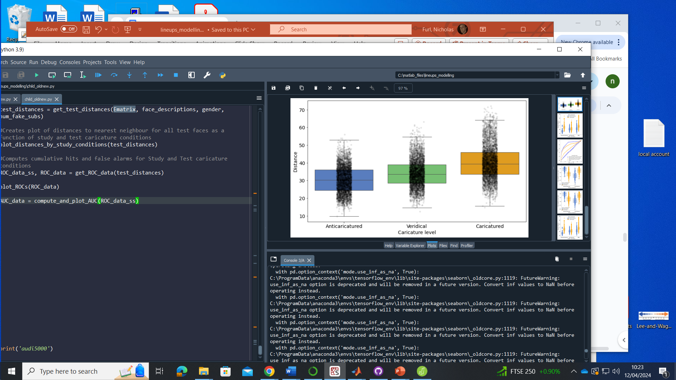
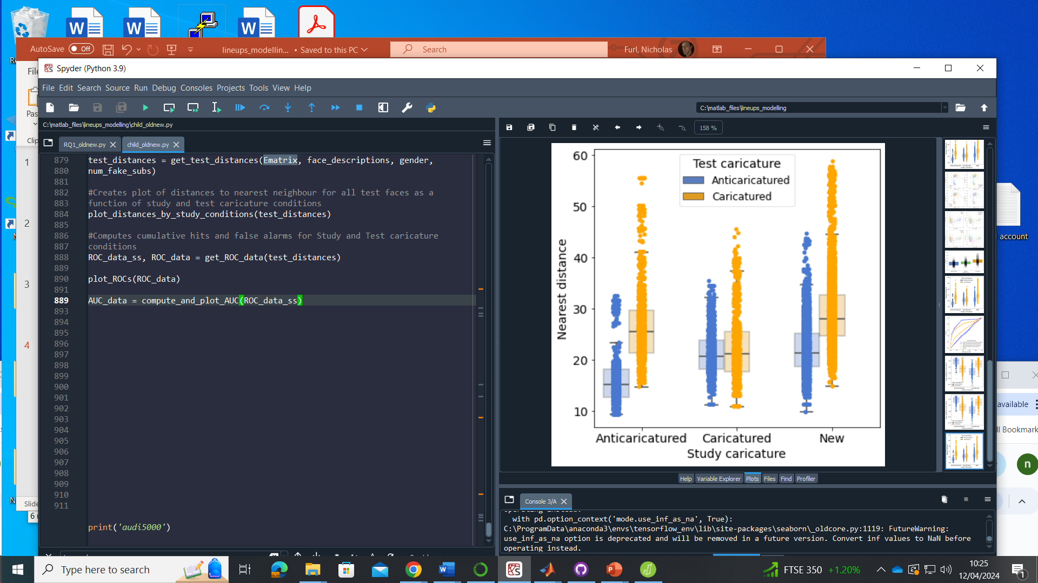
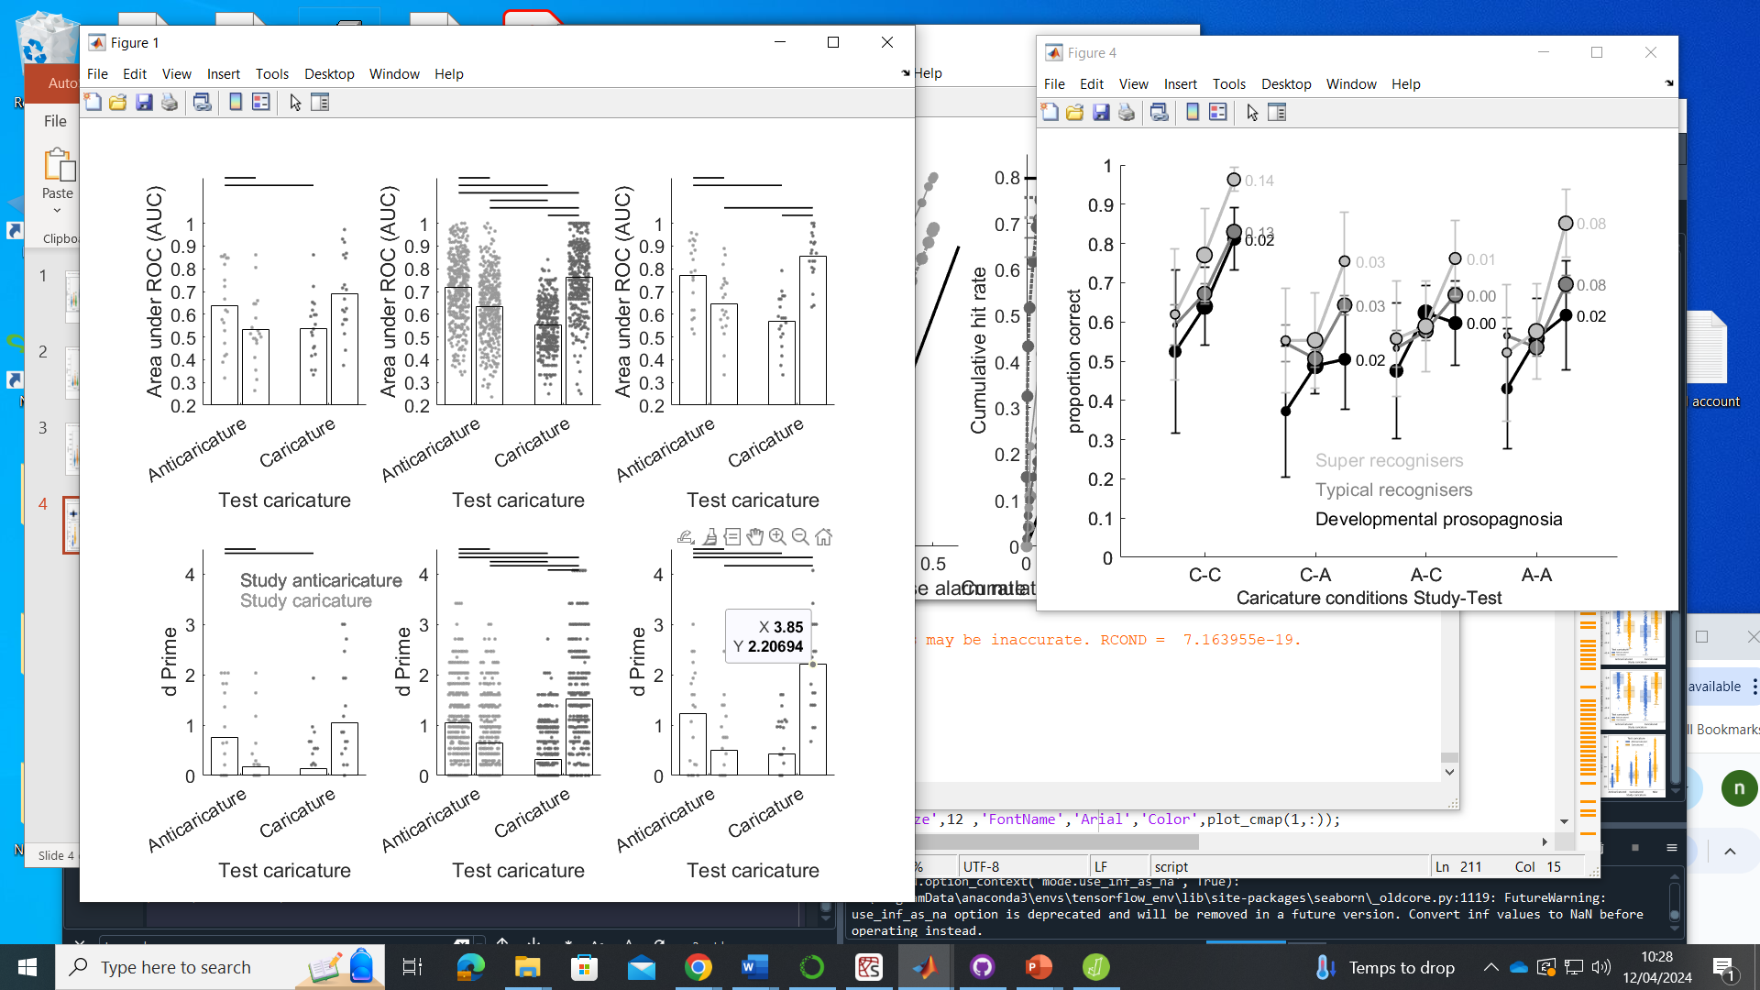
Child caricature – old / new recognition
imagenet

Slide 15
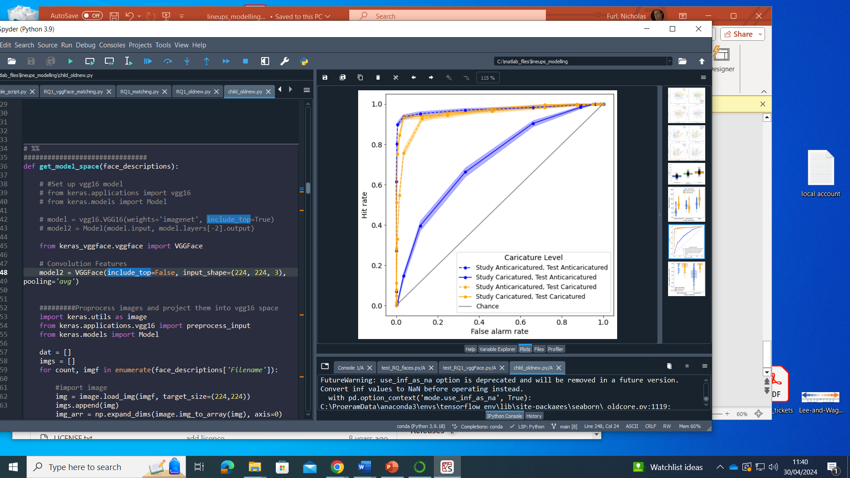
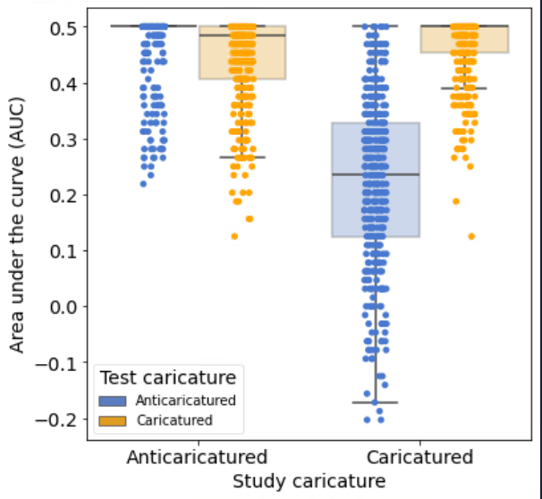
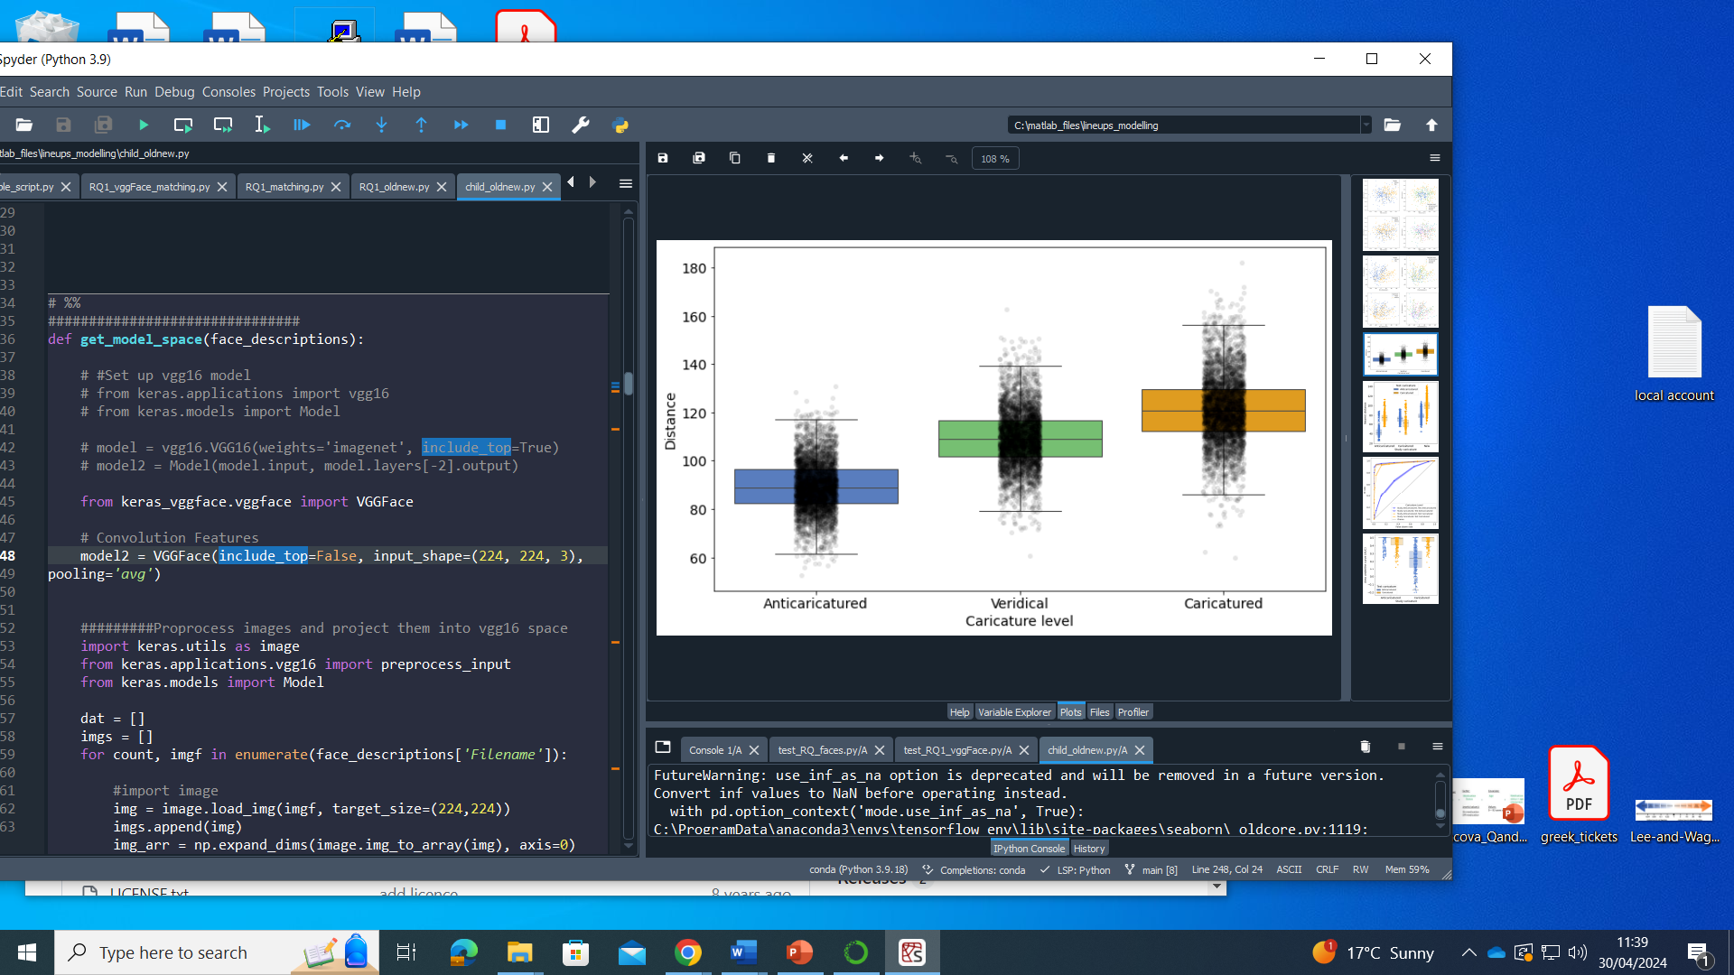
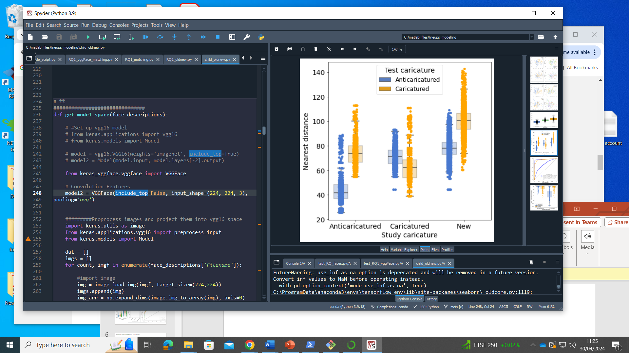
Child caricature – old / new recognition
vggFace

Slide 16
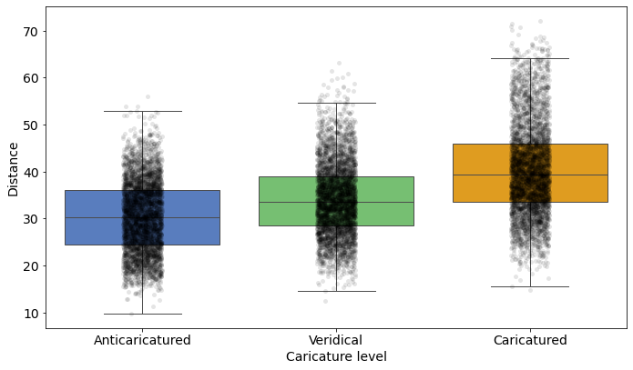
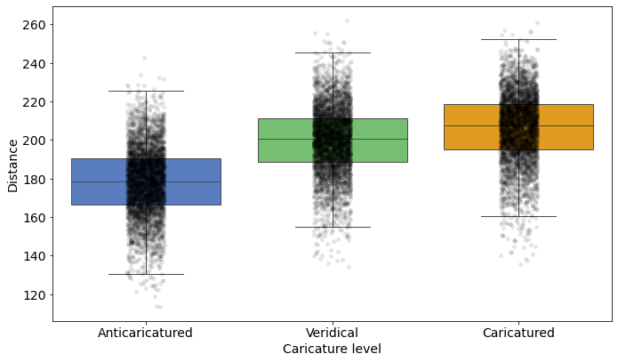
Caricature spreads out faces in face space
Imagenet vgg16
VggFACE2 SENet

Slide 17
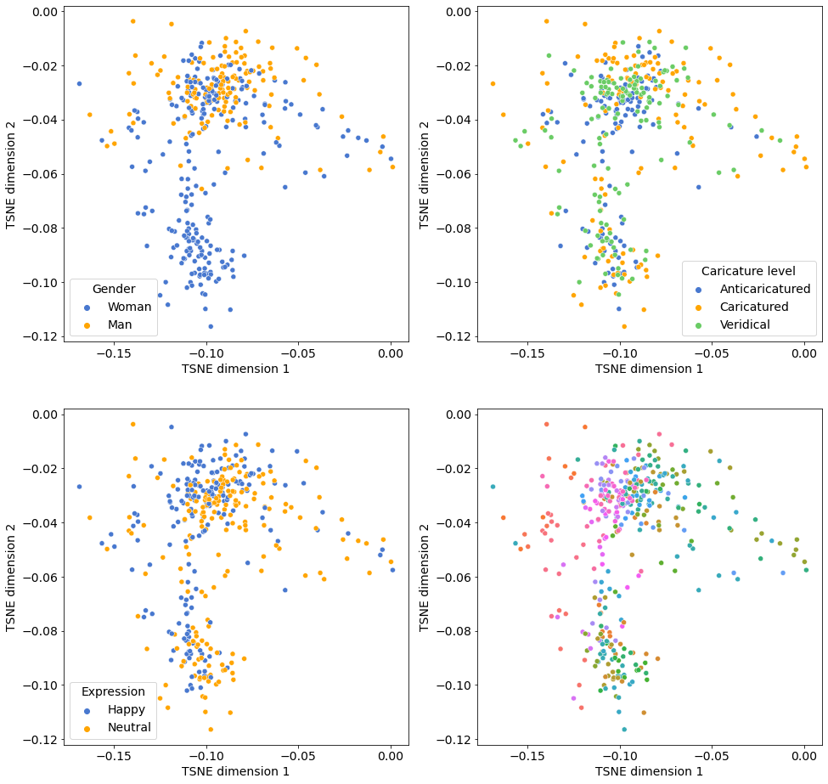
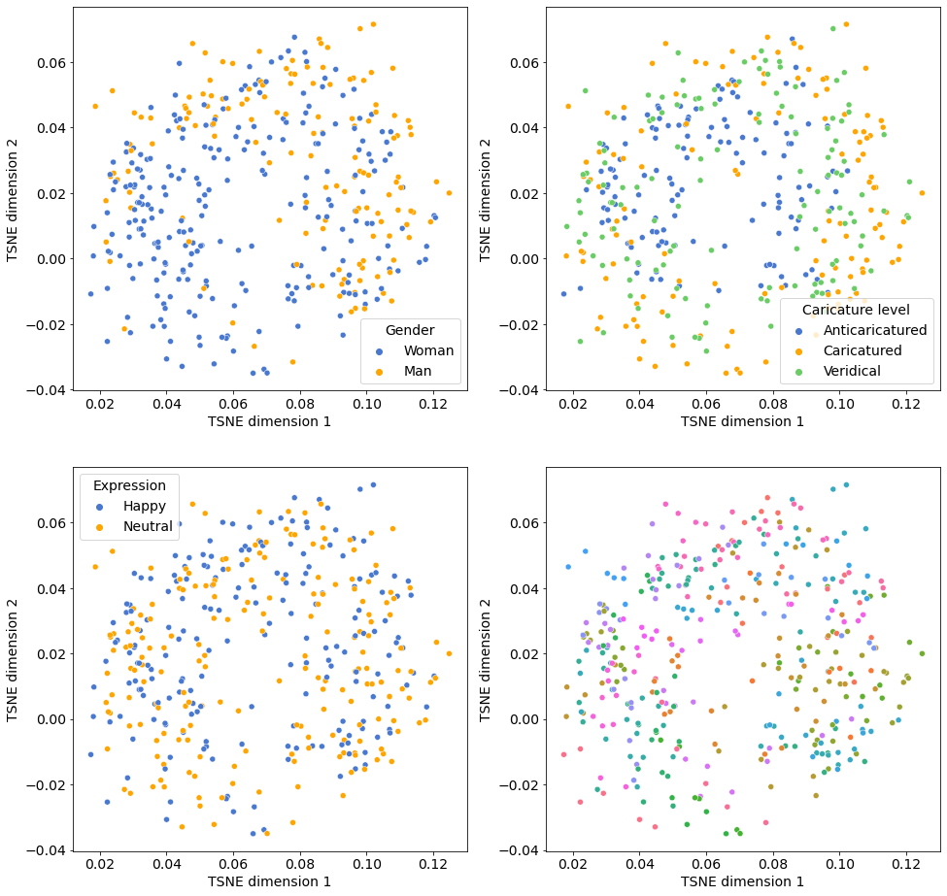
Caricature spreads out faces in face space
Imagenet vgg16
VggFACE2 SENet

Slide 18
Simulating old / new recognition
Create 400 simulated participants, each with same numbers of trials as experiment, populated with randomly selected faces
Euclidean distances between test faces & nearest study face
Old faces: shorter distances to study face means more hits
New faces: longer distances to study face means fewer false alarms
Sweep a decision criterion across distances
Distances < criterion: “old” response

Slide 19
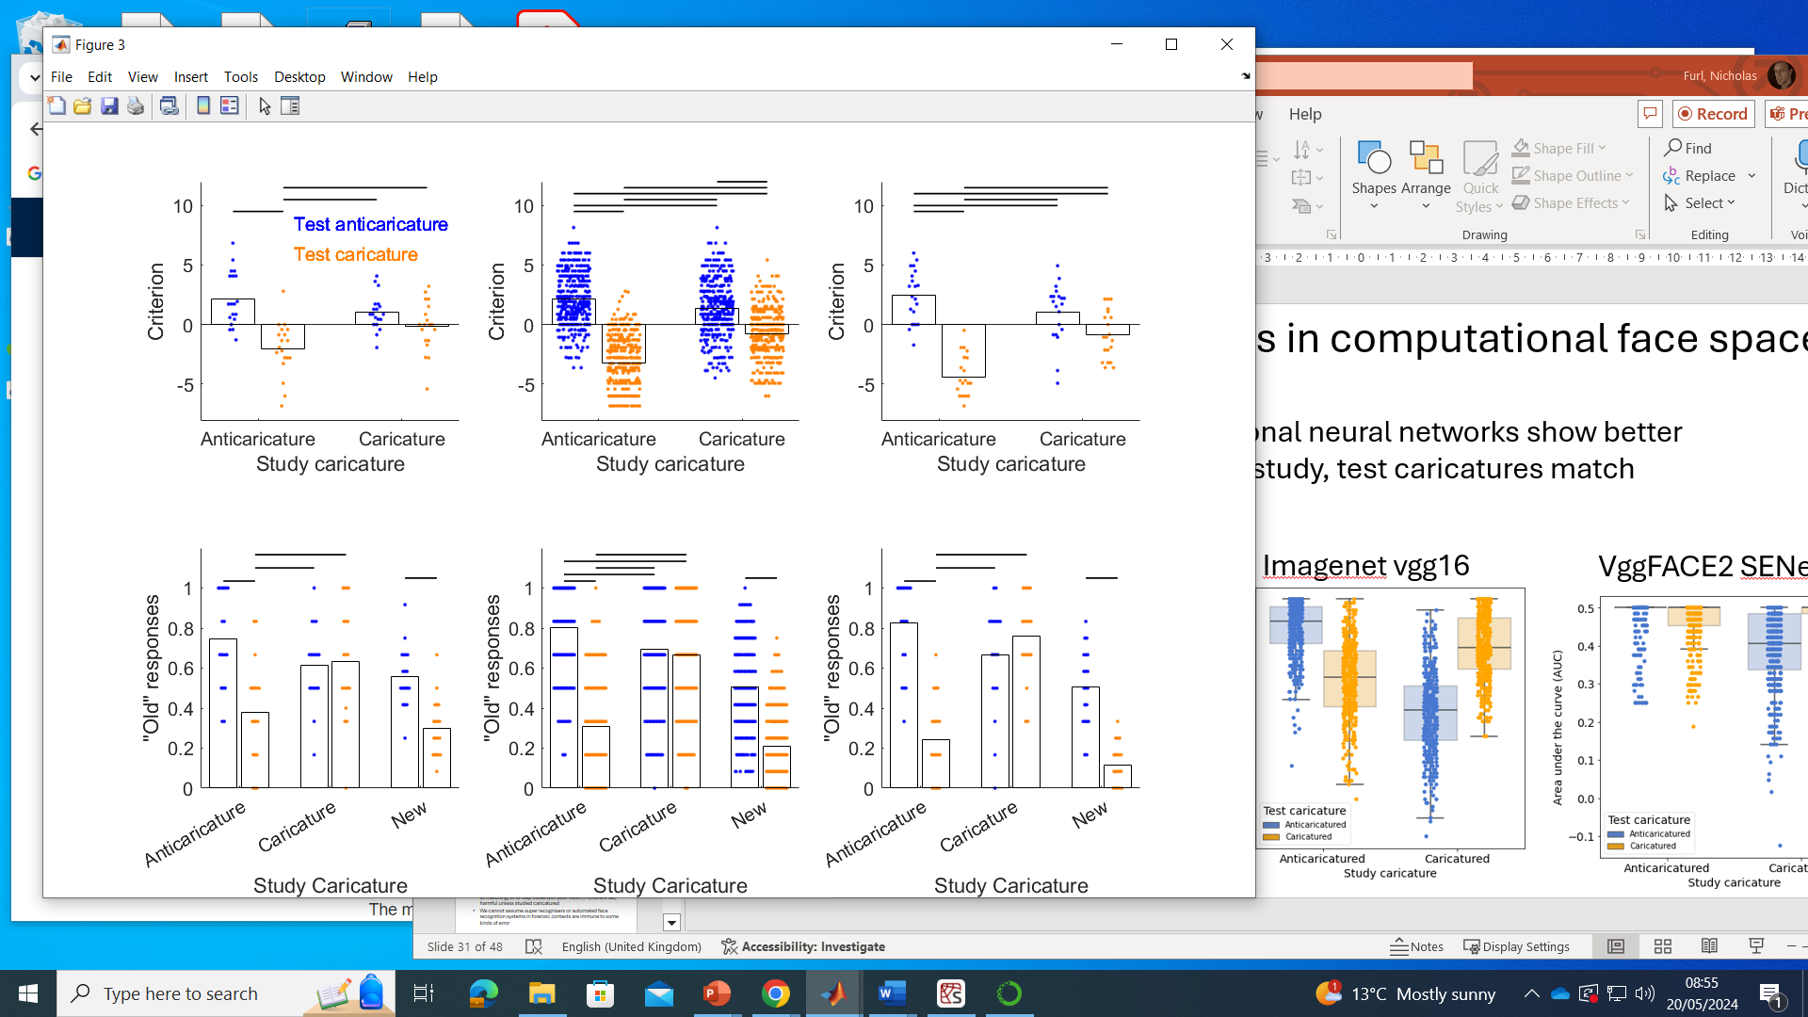
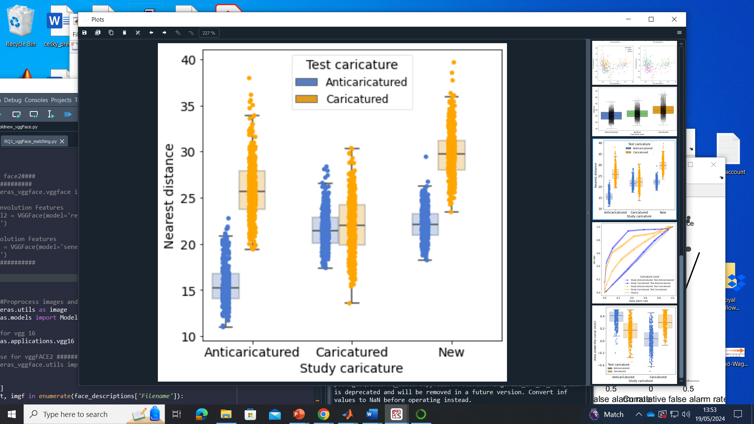
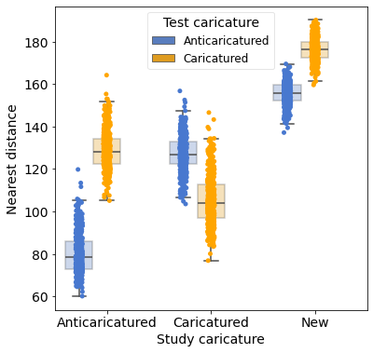

Are there super portrait effects?
No, hit rate suffers when caricature increased at test
Caricature of new faces improves false alarms
Model distances mirror human “old” judgements
Typical recognisers
Imagenet vgg16
VggFACE2 SENet

Slide 20



Are there super portrait effects?
No, deep convolutional neural networks show better performance when study, test caricatures match
Typical recognisers
Imagenet vgg16
VggFACE2 SENet

Slide 21



Are there super portrait effects?
No, deep convolutional neural networks show better performance when study, test caricatures match
Typical recognisers
Imagenet vgg16
VggFACE2 SENet

Slide 22
Is super recognition ability protective?
Super recognisers enhanced in conditions with matching caricature (C-C, A-A), but still make errors when mismatched (C-A, A-C)
Low recognisers
Typical recognisers
Super recognisers

Slide 23

Conclusions
Caricaturing unfamiliar test faces can hurt recognition
“Super portrait” idea unsupported
Caricature should match between study, test
Other data: Test caricature hurts matching & eyewitness lineups
Convolutional deep learning models show similar deficits
Intuitions about face space are not correct
Question for modelling: What about structure of face space gives rise to caricature-related deficits?

Slide 24



vggFACE lineups 18 July 2024 I don’t see any issue here
AUC plot matches distances, not ROC???
(Should AUC take on more than just three values???)
How can I get THIS plot from those distances?

Slide 25



Vgg16 lineups 18 July 2024

Slide 26

VGG16

Slide 27

VGG16
RQ1 lineup vgg16

Slide 28

VGG16

Slide 29

VGGFace

